Slide 1
State Space Representation
Stability and Control
Dr. E. A. Adjei
Unit One

Slide 2
OUTLINE
UNIT 1: State Space Representation
UNIT 2: Static & Dynamic Stability
UNIT 3: Derivation of Equations of Motion
UNIT 4: Solution of equations of motion using Transfer Function

Slide 3
Introduction
A modern complex system may have many inputs, many outputs, and these may be interrelated in a complicated manner. To analyze such a system, it is important to reduce the complexity of the mathematical expressions, as well as to resort to computers for most of the tedious computations necessary in the analysis. The state-space approach to the system analysis is best suited for this view point.
While conventional control theory is based on the input-output relationship or transfer function. Modern control theory is based on the description of system equations in terms of ‘n’ first order differential equation which may be combined into first order vector matrix differential equation. The use of vector matrix notation greatly simplifies the mathematical representation of systems of equations.

Slide 4
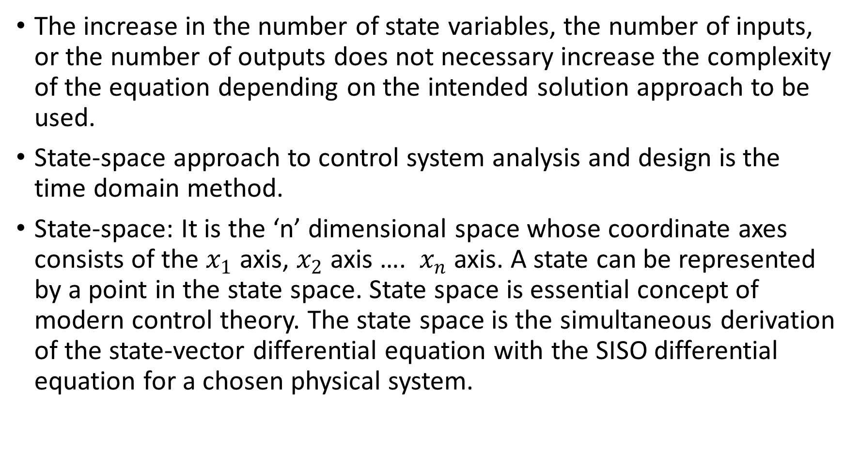
The increase in the number of state variables, the number of inputs, or the number of outputs does not necessary increase the complexity of the equation depending on the intended solution approach to be used.
State-space approach to control system analysis and design is the time domain method.
State-space: It is the ‘n’ dimensional space whose coordinate axes consists of the $x_{1}$ axis, $x_{2}$ axis …. $x_{n}$ axis. A state can be represented by a point in the state space. State space is essential concept of modern control theory. The state space is the simultaneous derivation of the state-vector differential equation with the SISO differential equation for a chosen physical system.

Slide 5

State vector: if ‘n’ variables are needed to completely describe the behaviour of a given system, the ‘n’ components of a vector ‘x’, such a vector is called a state vector. This is a vector that determines uniquely the system state x(t) for any time $t≥t_{o}$, once the state at $t=t_{o}$ is given and the input u(t) for $t≥t_{o}$ is specified.

Slide 6
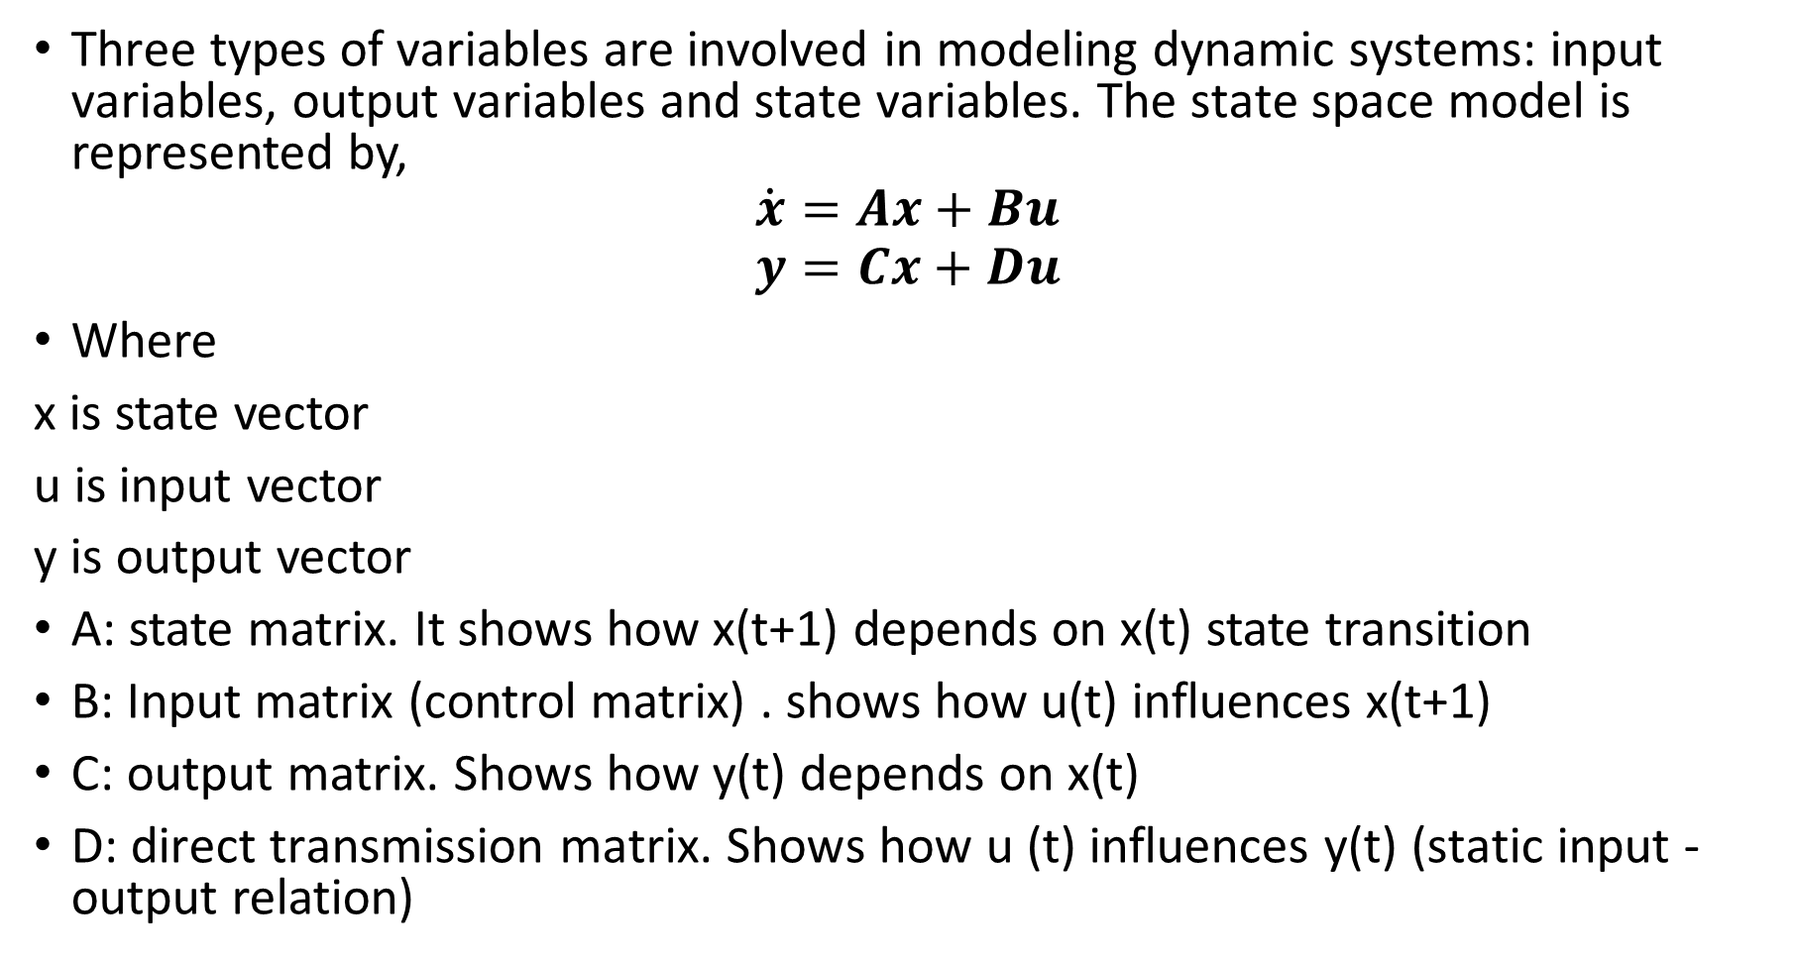
State Space Equations
Three types of variables are involved in modeling dynamic systems: input variables, output variables and state variables. The state space model is represented by,
$$\dot{x}=Ax+Bu$$
$$y=Cx+Du$$
Where
x is state vector
u is input vector
y is output vector
A: state matrix. It shows how x(t+1) depends on x(t) state transition
B: Input matrix (control matrix) . shows how u(t) influences x(t+1)
C: output matrix. Shows how y(t) depends on x(t)
D: direct transmission matrix. Shows how u (t) influences y(t) (static input -output relation)

Slide 7
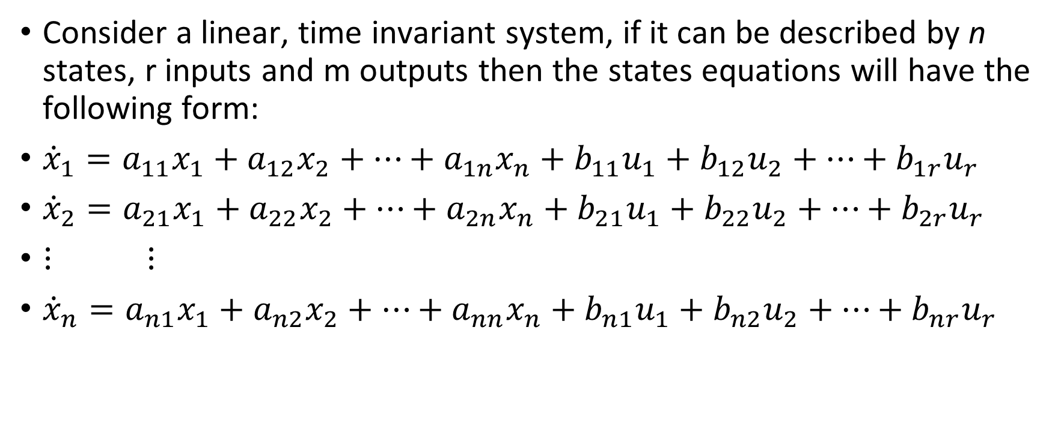
Example 1
Consider a linear, time invariant system, if it can be described by n states, r inputs and m outputs then the states equations will have the following form:
${\dot{x}}_{1}=a_{11}x_{1}+a_{12}x_{2}+…+a_{1n}x_{n}+b_{11}u_{1}+b_{12}u_{2}+…+b_{1r}u_{r}$
${\dot{x}}_{2}=a_{21}x_{1}+a_{22}x_{2}+…+a_{2n}x_{n}+b_{21}u_{1}+b_{22}u_{2}+…+b_{2r}u_{r}$
$⋮ ⋮$
${\dot{x}}_{n}=a_{n1}x_{1}+a_{n2}x_{2}+…+a_{nn}x_{n}+b_{n1}u_{1}+b_{n2}u_{2}+…+b_{nr}u_{r}$

Slide 8
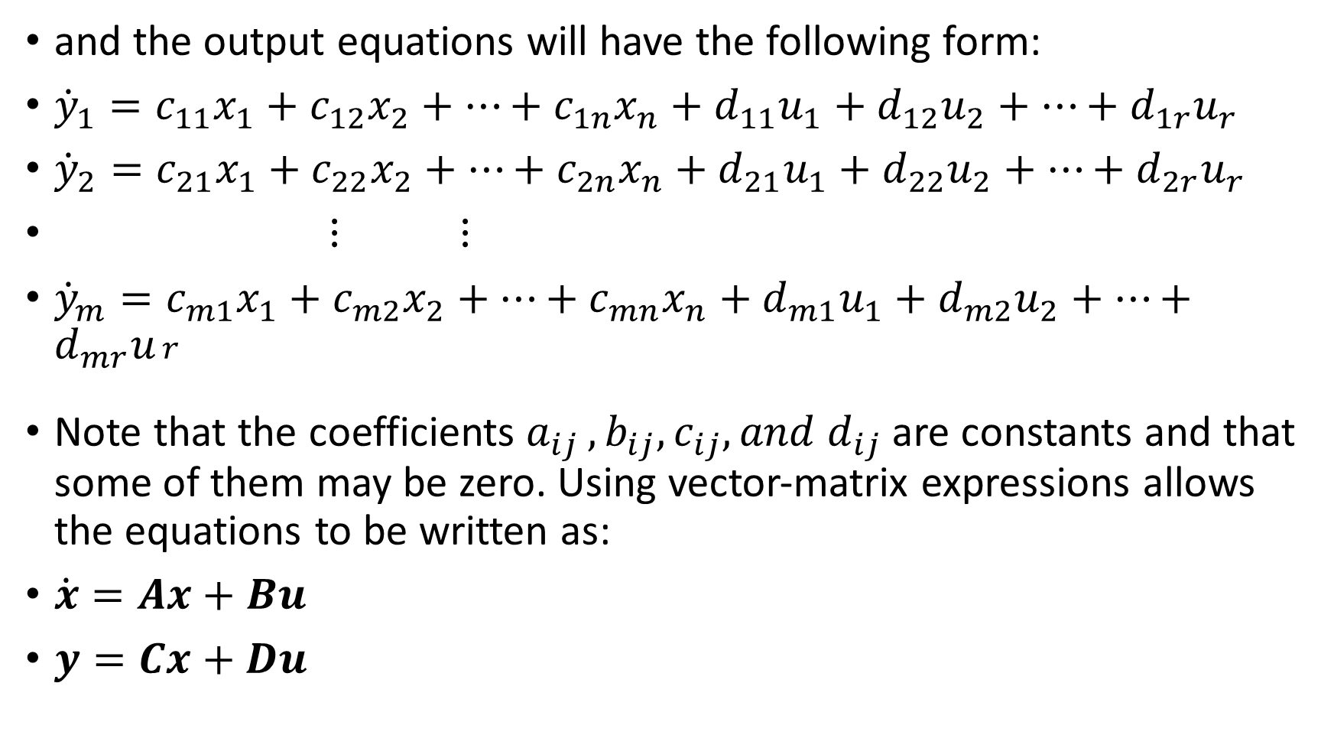
and the output equations will have the following form:
${\dot{y}}_{1}=c_{11}x_{1}+c_{12}x_{2}+…+c_{1n}x_{n}+d_{11}u_{1}+d_{12}u_{2}+…+d_{1r}u_{r}$
${\dot{y}}_{2}=c_{21}x_{1}+c_{22}x_{2}+…+{c_{2n}x}_{n}+d_{21}u_{1}+d_{22}u_{2}+…+d_{2r}u_{r}$
$⋮ ⋮$
${\dot{y}}_{m}=c_{m1}x_{1}+c_{m2}x_{2}+…+c_{mn}x_{n}+d_{m1}u_{1}+d_{m2}u_{2}+…+d_{mr}u_{\begin{aligned}r \\ \end{aligned}}$
Note that the coefficients $a_{ij }, b_{ij}, c_{ij}, and d_{ij}$ are constants and that some of them may be zero. Using vector-matrix expressions allows the equations to be written as:
$\dot{x}=Ax+Bu$
$y=Cx+Du$

Slide 9
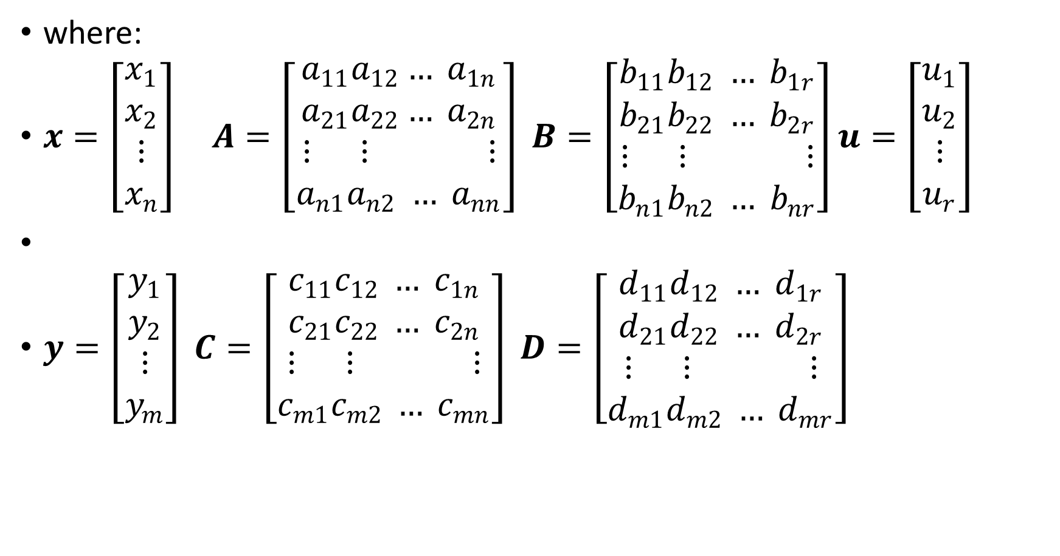
where:
$x=\left[\begin{aligned}x_{1} \\ x_{2} \\ ⋮ \\ x_{n}\end{aligned}\right] A=\left[\begin{aligned}a_{11}a_{12}… a_{1n} \\ a_{21}a_{22}… a_{2n} \\ ⋮ ⋮ ⋮ \\ a_{n1}a_{n2} … a_{nn}\end{aligned}\right] B=\left[\begin{aligned}b_{11}b_{12} … b_{1r} \\ b_{21}b_{22} … b_{2r} \\ ⋮ ⋮ ⋮ \\ b_{n1}b_{n2} … b_{nr}\end{aligned}\right]u=\left[\begin{aligned}u_{1} \\ u_{2} \\ ⋮ \\ u_{r}\end{aligned}\right]$
$y=\left[\begin{aligned}y_{1} \\ y_{2} \\ ⋮ \\ y_{m}\end{aligned}\right] C=\left[\begin{aligned}c_{11}c_{12} … c_{1n} \\ c_{21}c_{22} … c_{2n} \\ ⋮ ⋮ ⋮ \\ c_{m1}c_{m2} … c_{mn}\end{aligned}\right] D=\left[\begin{aligned}d_{11}d_{12} … d_{1r} \\ d_{21}d_{22} … d_{2r} \\ ⋮ ⋮ ⋮ \\ d_{m1}d_{m2} … d_{mr}\end{aligned}\right]$

Slide 10

Example 2
For example, suppose that the physical system being modelled can be described by an nth – order differential equation:
$\frac{d^{n}c(t)}{dt^{n}}+a_{1}\frac{d^{n−1}c(t)}{dt^{n−1}}+a_{2}\frac{d^{n−2}c(t)}{dt^{n−2}}+…+a_{n−1}\frac{dc(t)}{dt}+a_{n}c\left(t\right)=r(t)$

Slide 11
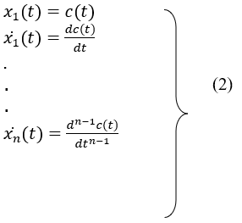
The variables c(t) and r(t) are the output and input variables, respectively. The above differential equation can be reduced to a set of first-order differential equations by defining the state variables as follows:

Slide 12
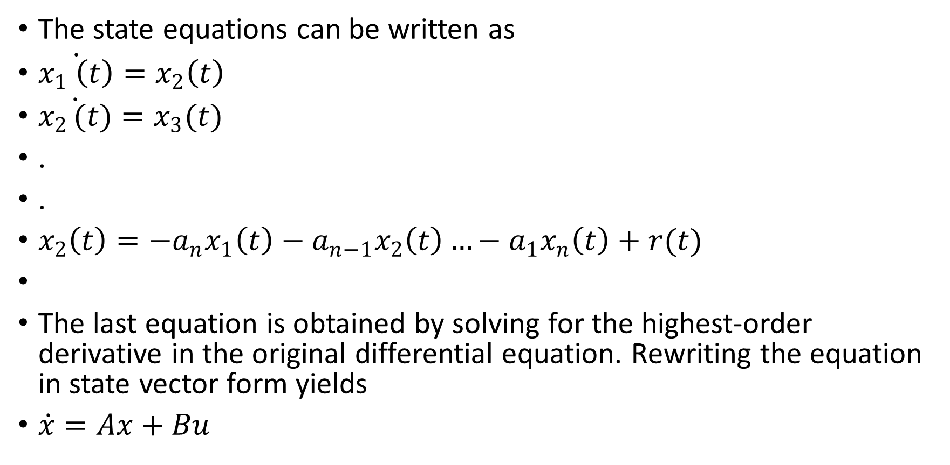
The state equations can be written as
$\dot{x_{1} \left(t\right)}=x_{2}\left(t\right)$
$\dot{x_{2 }(t)}=x_{3}(t)$
.
.
$x_{2}\left(t\right)=−a_{n}x_{1}\left(t\right)−a_{n−1}x_{2}\left(t\right)…−a_{1}x_{n}\left(t\right)+r(t)$
The last equation is obtained by solving for the highest-order derivative in the original differential equation. Rewriting the equation in state vector form yields
$\dot{x}=Ax+Bu$

Slide 13

Where
$A=\left[\begin{matrix}0 & 1 & 0 & 0 & 0 & . & 0 \\ 0 & 0 & 1 & 0 & 0 & . & 0 \\ 0 & 0 & 0 & 1 & 0 & . & 0 \\ . & . & . & . & . & . & 0 \\ . & . & . & . & . & . & 0 \\ 0 & 0 & 0 & 0 & 0 & . & 1 \\ −a_{n} & −a_{n−1} & −a_{n−2} & −a_{n−3} & −a_{n−4} & . & −a_{1}\end{matrix}\right]$
$B=\left[\begin{matrix}0 \\ 0 \\ 0 \\ 0 \\ . \\ . \\ 1\end{matrix}\right]$
The output equation $y=Cx$
Where $C=\left[\begin{matrix}1 & 0 & 0 & . & . & 0\end{matrix}\right]$

Slide 14
State Space Formulation
Steps in modelling
Understand the physical system and its components
Make appropriate simplifying assumptions
Use basic principles to formulate the mathematical model
Write differential and algebraic equations describing the model
Check the model for validity

Slide 15
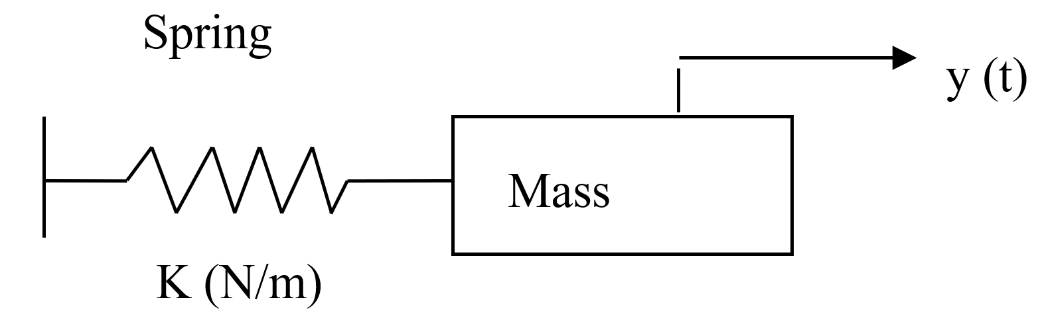
Example
Consider a mass M, on a frictionless surface connected to a rigid wall by a spring with stiffness K. Obtain the mathematical model for the system.

Slide 16
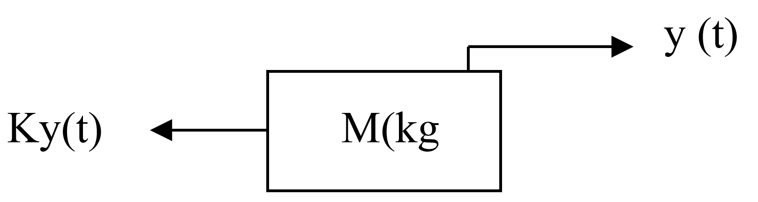
Solution:
Choose a sign convention for the position variable y (t). NB that the sign convention for velocity and acceleration are the same as that for displacement.
Use fundamental physical principles to model the system (Newton’s law)
Draw free body diagrams of the system. In this example, the spring force is the only force acting on the mass.

Slide 17
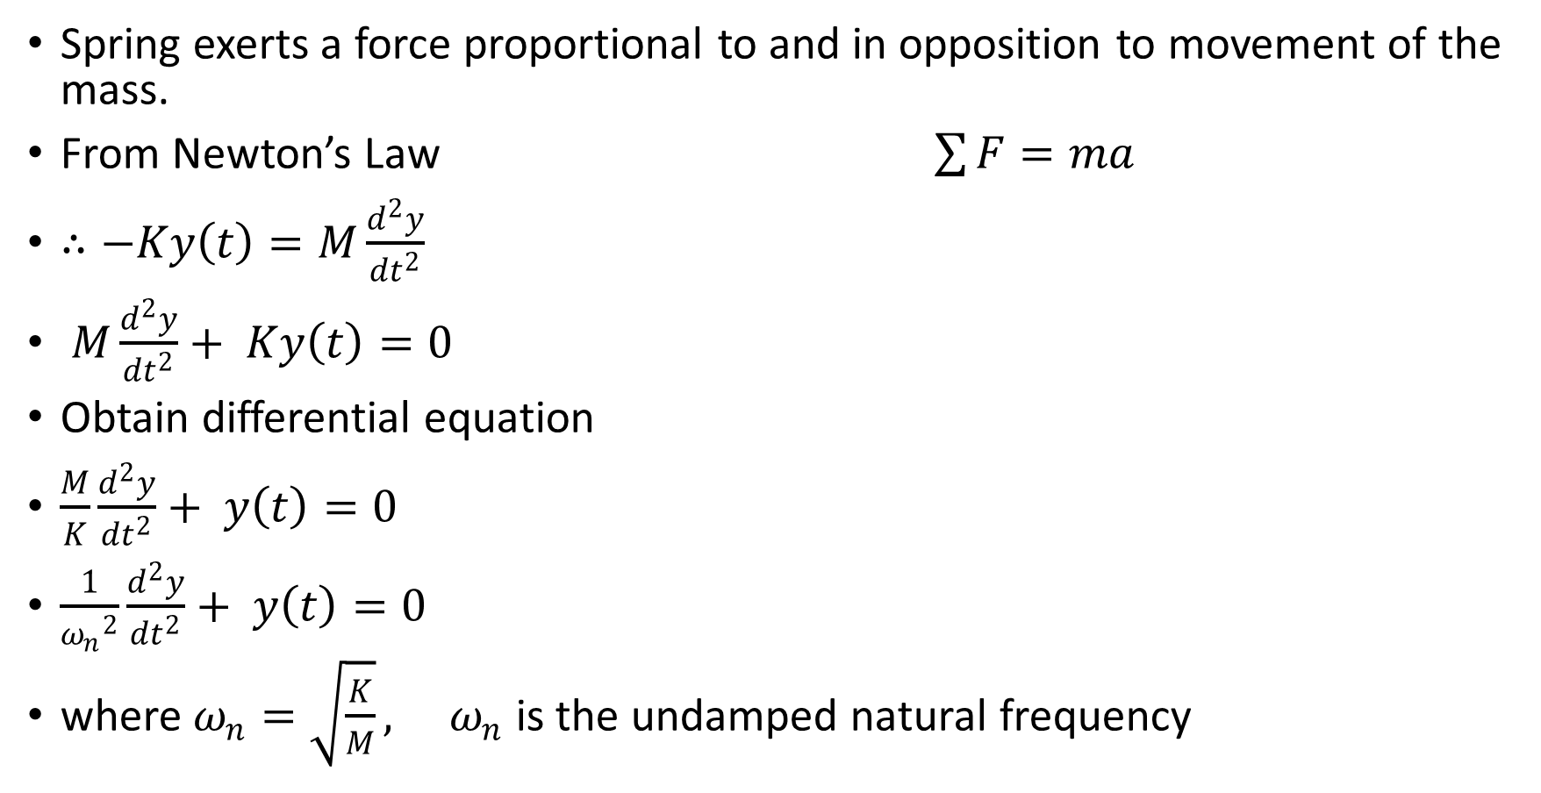
Spring exerts a force proportional to and in opposition to movement of the mass.
From Newton’s Law $\sum{F}=ma$
$∴−Ky\left(t\right)=M\frac{d^{2}y}{{dt}^{2}}$
$M\frac{d^{2}y}{{dt}^{2}}+ Ky\left(t\right)=0$
Obtain differential equation
$\frac{M}{K}\frac{d^{2}y}{{dt}^{2}}+ y\left(t\right)=0$
$\frac{1}{{ω_{n}}^{2}}\frac{d^{2}y}{{dt}^{2}}+ y\left(t\right)=0$
where $ω_{n}=\sqrt{\frac{K}{M}}, ω_{n}$ is the undamped natural frequency

Slide 18
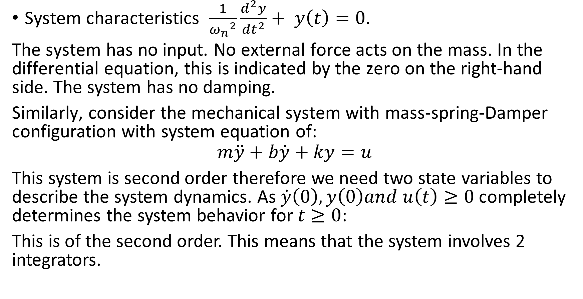
System characteristics $\frac{1}{{ω_{n}}^{2}}\frac{d^{2}y}{{dt}^{2}}+ y\left(t\right)=0.$
The system has no input. No external force acts on the mass. In the differential equation, this is indicated by the zero on the right-hand side. The system has no damping.
Similarly, consider the mechanical system with mass-spring-Damper configuration with system equation of:
$$m\ddot{y}+b\dot{y}+ky=u$$
This system is second order therefore we need two state variables to describe the system dynamics. As $\dot{y}\left(0\right),y\left(0\right)and u\left(t\right)≥0$ completely determines the system behavior for $t≥0$:
This is of the second order. This means that the system involves 2 integrators.

Slide 19

Step 1
Define the state variables as
x₁ (t)=y(t) (5)
x₂ (t)=y ̇(t) (6)
Then we obtain
x ̇₁=x₂
x ̇=$\frac{1}{m} (−ky−by ̇ )+\frac{1}{m} u$
Or
x ̇=x₂ (7)
$\dot{\left(x2 \right)}=−\frac{k}{m}x_{1}−\frac{b}{m}x_{2}+\frac{1}{m}u$(8)
The output equation is
y=x₁ (9)

Slide 20
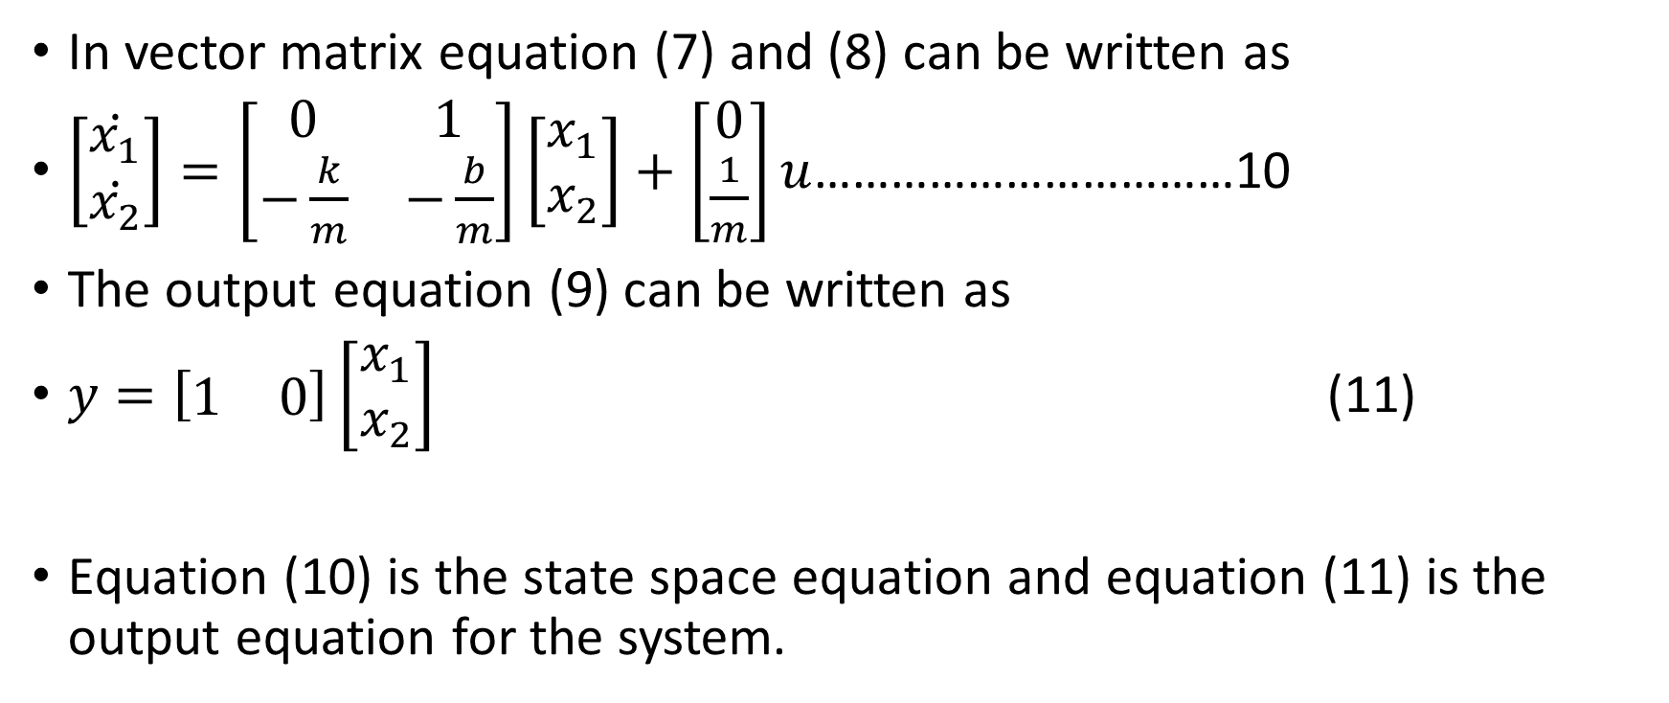
In vector matrix equation (7) and (8) can be written as
$\left[\begin{matrix}\dot{x_{1}} \\ \dot{x_{2}}\end{matrix}\right]=\left[\begin{matrix}0 & 1 \\ −\frac{k}{m} & −\frac{b}{m}\end{matrix}\right]\left[\begin{matrix}x_{1} \\ x_{2}\end{matrix}\right]+\left[\begin{matrix}0 \\ \frac{1}{m}\end{matrix}\right]u$……………………………10
The output equation (9) can be written as
$y=\left[\begin{matrix}1 & 0\end{matrix}\right]\left[\begin{matrix}x_{1} \\ x_{2}\end{matrix}\right]$ (11)
Equation (10) is the state space equation and equation (11) is the output equation for the system.

Slide 21

Equation (10) and (11) are in the standard form:
$\dot{x}=Ax+Bu$
$y=Cx+Du$
Where
$A=\left[\begin{matrix}0 & 1 \\ −\frac{k}{m} & −\frac{b}{m}\end{matrix}\right] B=\left[\begin{matrix}0 \\ \frac{1}{m}\end{matrix}\right] C=\left[\begin{matrix}1 & 0\end{matrix}\right] D=0$

Slide 22

Example 3
Obtain the state equation in phase variable form for the following differential equation:
$2\frac{d^{3}y}{{dt}^{3}}+4\frac{d^{2}y}{{dt}^{2}}+6\frac{dy}{dt}+8y=10u(t)$

Slide 23
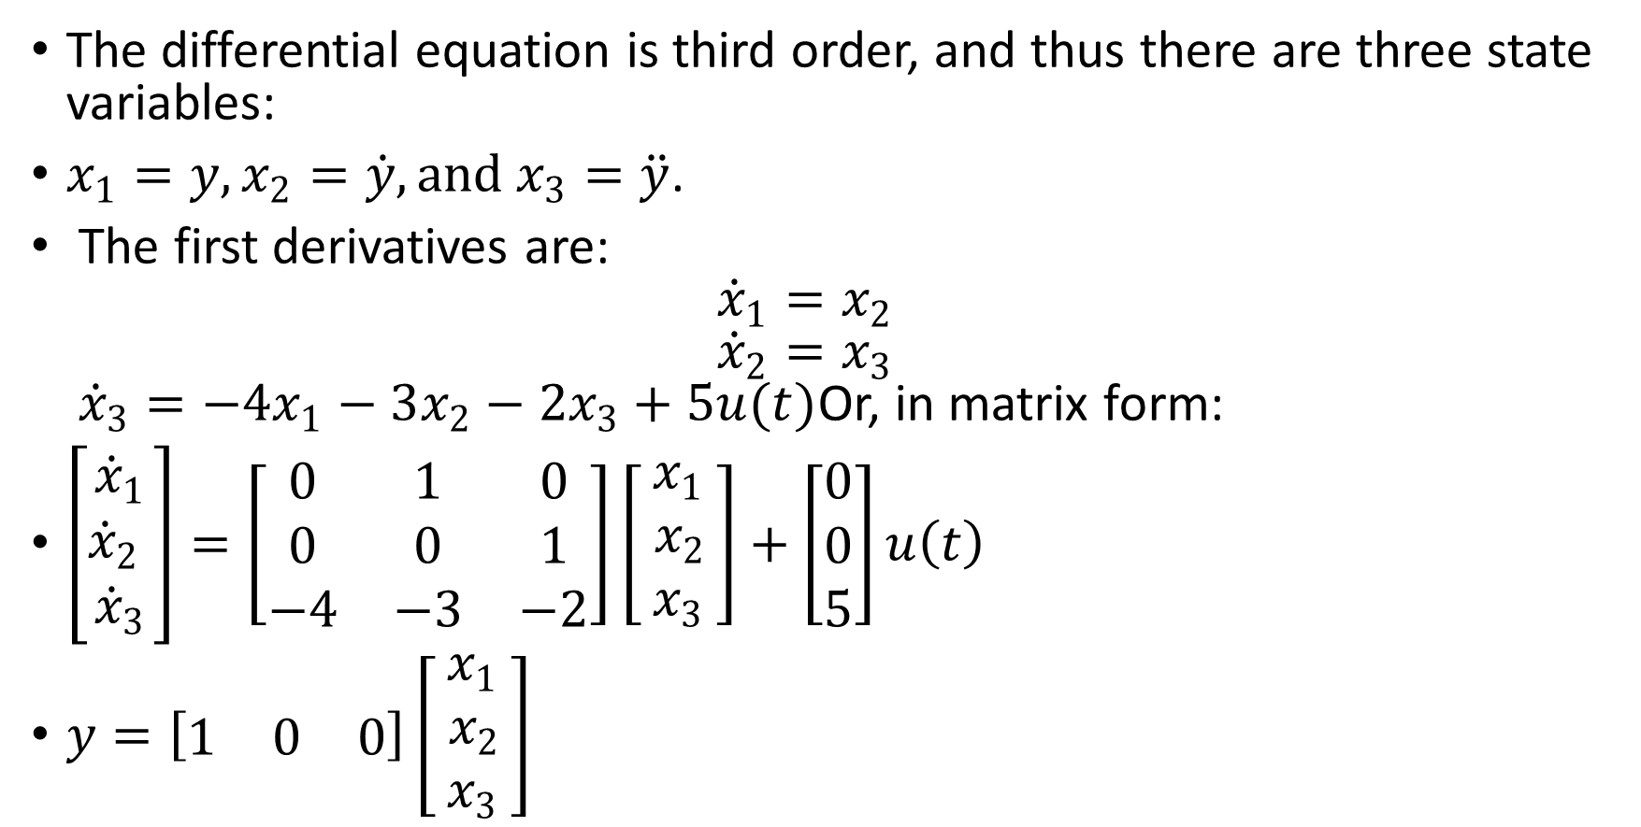
Solution
The differential equation is third order, and thus there are three state variables:
$x_{1}=y, x_{2}=\dot{y},and x_{3}=\ddot{y}$.
The first derivatives are: ${\dot{x}}_{1}=x_{2}$ ${\dot{x}}_{2}=x_{3}$ ${\dot{x}}_{3}=−4x_{1}−3x_{2}−2x_{3}+5u(t)$Or, in matrix form:
$\left[\begin{matrix}{\dot{x}}_{1} \\ {\dot{x}}_{2} \\ {\dot{x}}_{3}\end{matrix}\right]=\left[\begin{matrix}0 & 1 & 0 \\ 0 & 0 & 1 \\ −4 & −3 & −2\end{matrix}\right]\left[\begin{matrix}x_{1} \\ { x}_{2 } \\ x_{3}\end{matrix}\right]+\left[\begin{matrix}0 \\ 0 \\ 5\end{matrix}\right]u\left(t\right)$
$y=\left[\begin{matrix}1 & 0 & 0\end{matrix}\right]\left[\begin{matrix}x_{1} \\ { x}_{2 } \\ x_{3}\end{matrix}\right]$

Slide 24
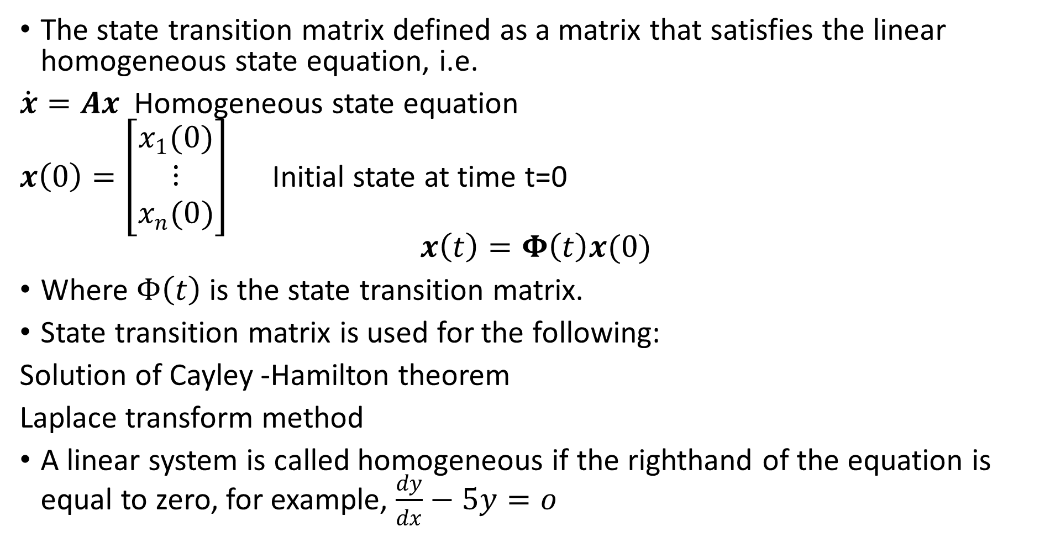
State Transition Matrix
The state transition matrix defined as a matrix that satisfies the linear homogeneous state equation, i.e.
$\dot{x}=Ax$Homogeneous state equation
$x\left(0\right)=\left[\begin{aligned}x_{1}(0) \\ ⋮ \\ x_{n}(0)\end{aligned}\right]$ Initial state at time t=0
$$x\left(t\right)=Φ\left(t\right)x(0)$$
Where $Φ\left(t\right)$ is the state transition matrix.
State transition matrix is used for the following:
Solution of Cayley -Hamilton theorem
Laplace transform method
A linear system is called homogeneous if the righthand of the equation is equal to zero, for example, $\frac{dy}{dx}−5y=o$

Slide 25
Work Example
Find a physical homogeneous system and identify areas of application of state transition matrix.

Slide 26
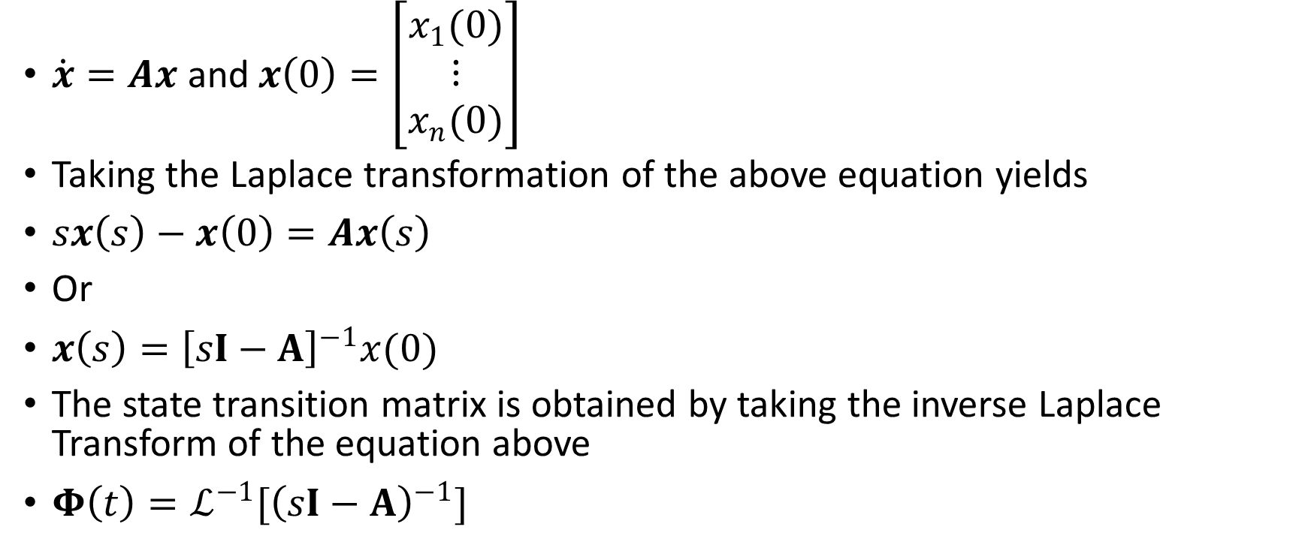
State Transition Matrix By Laplace Transformation Technique
$\dot{x}=Ax$and$x\left(0\right)=\left[\begin{aligned}x_{1}(0) \\ ⋮ \\ x_{n}(0)\end{aligned}\right]$
Taking the Laplace transformation of the above equation yields
$sx\left(s\right)−x\left(0\right)=Ax\left(s\right)$
Or
$x\left(s\right)={\left[sI−A\right]}^{−1}x(0)$
The state transition matrix is obtained by taking the inverse Laplace Transform of the equation above
$Φ\left(t\right)=ℒ^{−1}[{\left(sI−A\right)}^{−1}]$

Slide 27
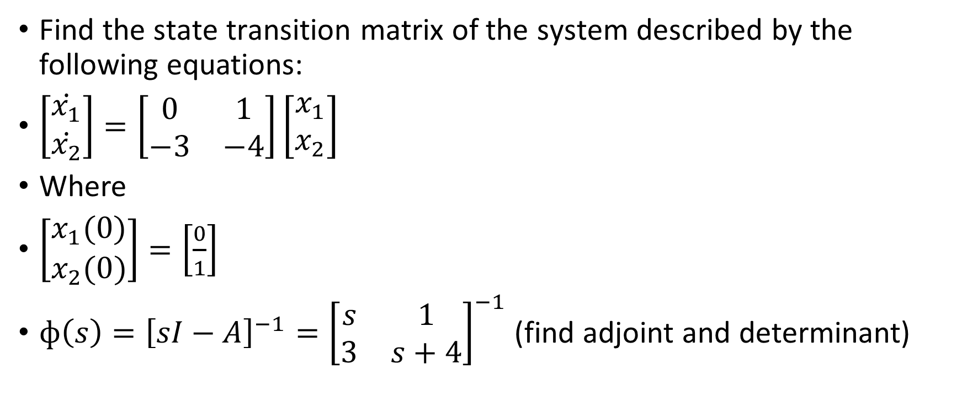
Example
Find the state transition matrix of the system described by the following equations:
$\left[\begin{matrix}\dot{x_{1}} \\ \dot{x_{2}}\end{matrix}\right]=\left[\begin{matrix}0 & 1 \\ −3 & −4\end{matrix}\right]\left[\begin{matrix}x_{1} \\ x_{2}\end{matrix}\right]$
Where
$\left[\begin{matrix}x_{1}(0) \\ x_{2}(0)\end{matrix}\right]=\left[\frac{0}{1}\right]$
$ф\left(s\right)={\left[sI−A\right]}^{−1}={\left[\begin{matrix}s & 1 \\ 3 & s+4\end{matrix}\right]}^{−1}$ (find adjoint and determinant)

Slide 28
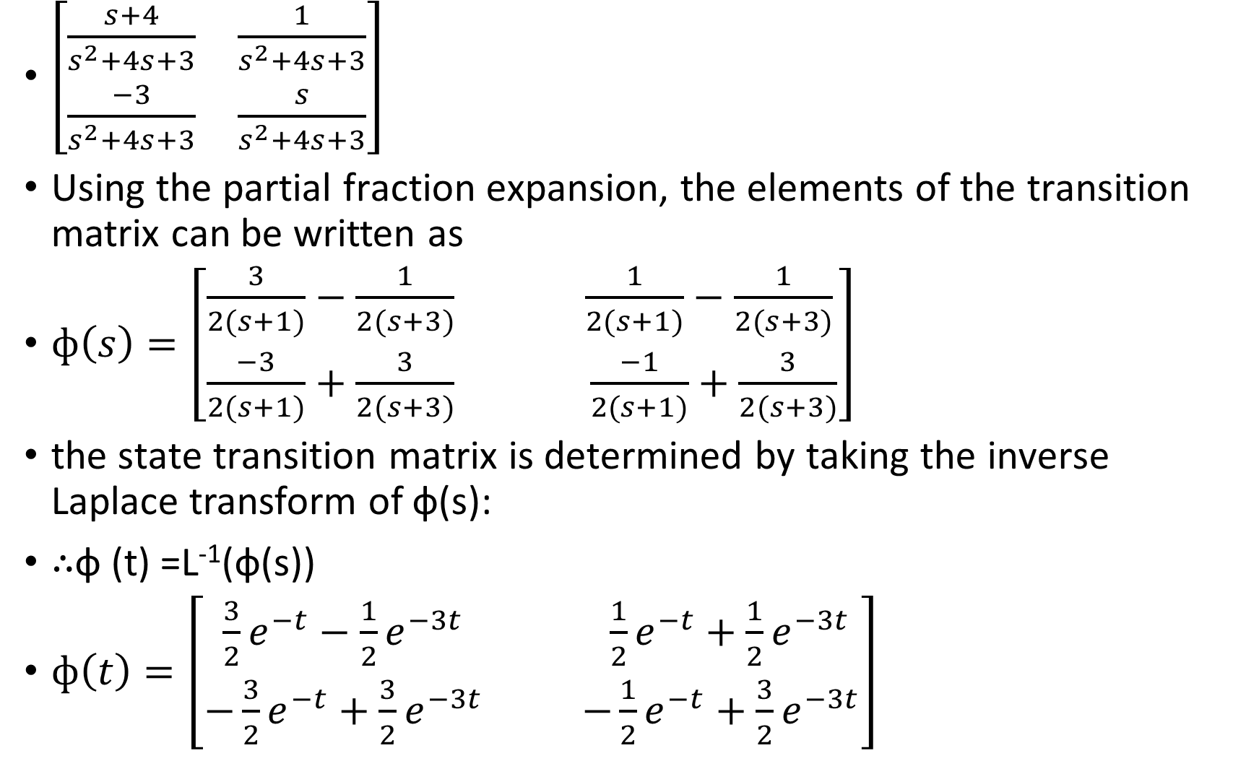
$\left[\begin{matrix}\frac{s+4}{s^{2}+4s+3} & \frac{1}{s^{2}+4s+3} \\ \frac{−3}{s^{2}+4s+3} & \frac{s}{s^{2}+4s+3}\end{matrix}\right]$
Using the partial fraction expansion, the elements of the transition matrix can be written as
$ф\left(s\right)=\left[\begin{matrix}\frac{3}{2(s+1)}−\frac{1}{2(s+3)} & \frac{1}{2(s+1)}−\frac{1}{2(s+3)} \\ \frac{−3}{2(s+1)}+\frac{3}{2(s+3)} & \frac{−1}{2(s+1)}+\frac{3}{2(s+3)}\end{matrix}\right]$
the state transition matrix is determined by taking the inverse Laplace transform of ф(s):
∴ф (t) =L⁻¹(ф(s))
$ф\left(t\right)=\left[\begin{matrix}\frac{3}{2}e^{−t}−\frac{1}{2}e^{−3t} & \frac{1}{2}e^{−t}+\frac{1}{2}e^{−3t} \\ −\frac{3}{2}e^{−t}+\frac{3}{2}e^{−3t} & −\frac{1}{2}e^{−t}+\frac{3}{2}e^{−3t}\end{matrix}\right]$

Slide 29
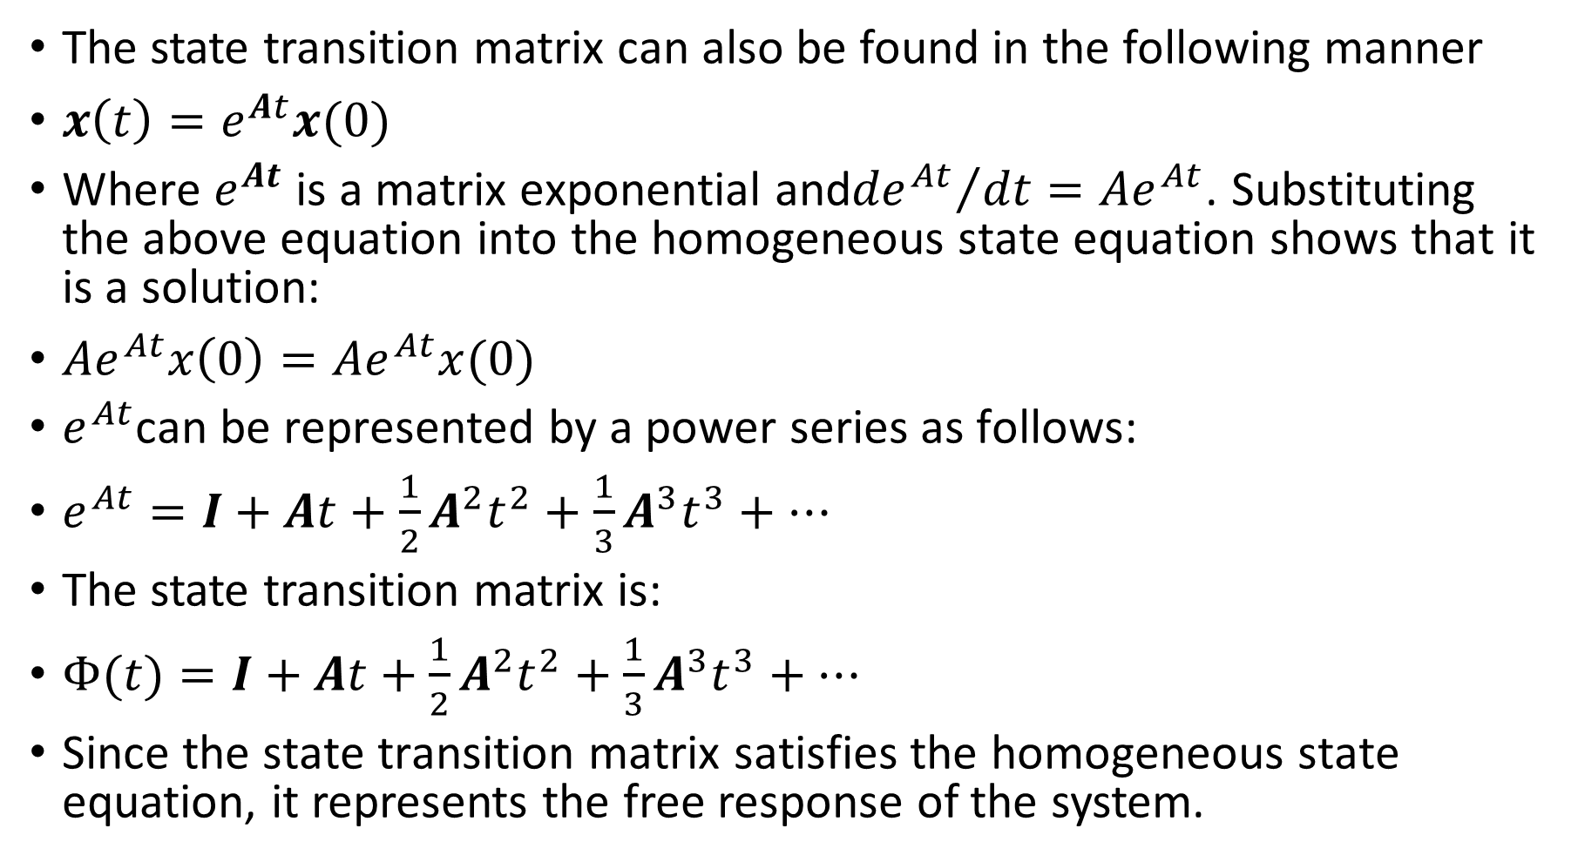
State Transition Matrix by Classical Technique
The state transition matrix can also be found in the following manner
$x\left(t\right)=e^{At}x(0)$
Where $e^{At}$ is a matrix exponential and${{de}^{At}}/{dt={Ae}^{At}}$. Substituting the above equation into the homogeneous state equation shows that it is a solution:
${Ae}^{At}x\left(0\right)={Ae}^{At}x(0)$
$e^{At}$can be represented by a power series as follows:
$e^{At}=I+At+\frac{1}{2}A^{2}t^{2}+\frac{1}{3}A^{3}t^{3}+…$
The state transition matrix is:
$Φ(t)=I+At+\frac{1}{2}A^{2}t^{2}+\frac{1}{3}A^{3}t^{3}+…$
Since the state transition matrix satisfies the homogeneous state equation, it represents the free response of the system.

Slide 30
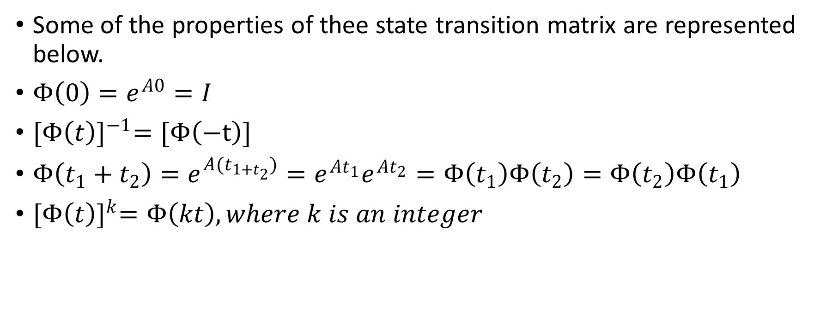
Properties of the State Transition Matrix
Some of the properties of thee state transition matrix are represented below.
$Φ\left(0\right)=e^{A0}=I$
${[Φ\left(t\right)]}^{−1}=[Φ\left(−t\right)]$
$Φ\left(t_{1}+t_{2}\right)=e^{A(t_{1+t_{2}})}=e^{At_{1}}e^{At_{2}}=Φ\left(t_{1}\right)Φ\left(t_{2}\right)=Φ\left(t_{2}\right)Φ\left(t_{1}\right)$
${[Φ\left(t\right)]}^{k}=Φ\left(kt\right), where k is an integer$

Slide 31
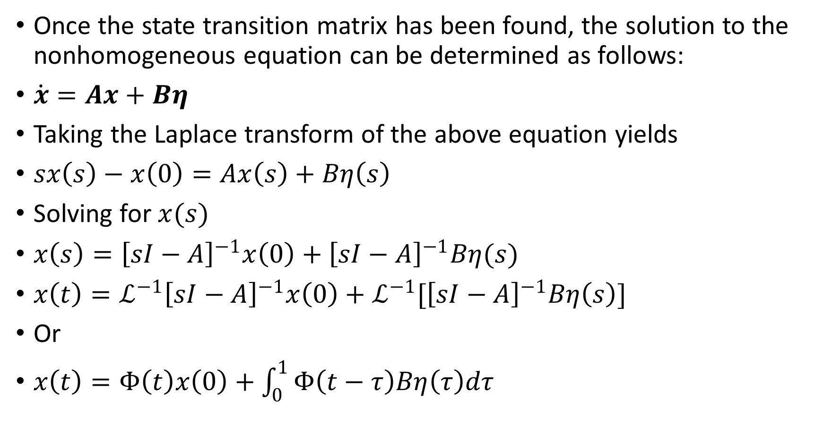
Once the state transition matrix has been found, the solution to the nonhomogeneous equation can be determined as follows:
$\dot{x}=Ax+Bη$
Taking the Laplace transform of the above equation yields
$sx\left(s\right)−x\left(0\right)=Ax\left(s\right)+Bη\left(s\right)$
Solving for $x(s)$
$x\left(s\right)={\left[sI−A\right]}^{−1}x\left(0\right)+{\left[sI−A\right]}^{−1}Bη(s)$
$x\left(t\right)=ℒ^{−1}{\left[sI−A\right]}^{−1}x\left(0\right)+ℒ^{−1}[{\left[sI−A\right]}^{−1}Bη\left(s\right)]$
Or
$x\left(t\right)=Φ\left(t\right)x\left(0\right)+\int_{0}^{1}{Φ\left(t−τ\right)Bη\left(τ\right)dτ}$

Slide 32
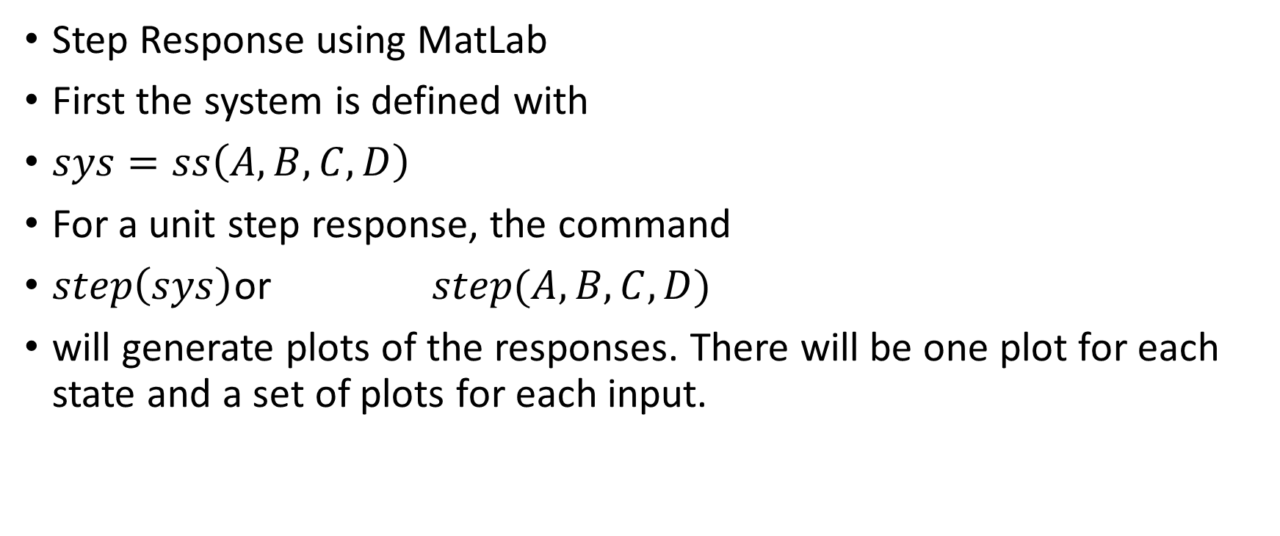
Transient-Response Analysis of State-Space Systems
Step Response using MatLab
First the system is defined with
$sys=ss\left(A,B,C,D\right)$
For a unit step response, the command
$step\left(sys\right)$or$step(A,B,C,D)$
will generate plots of the responses. There will be one plot for each state and a set of plots for each input.

Slide 33
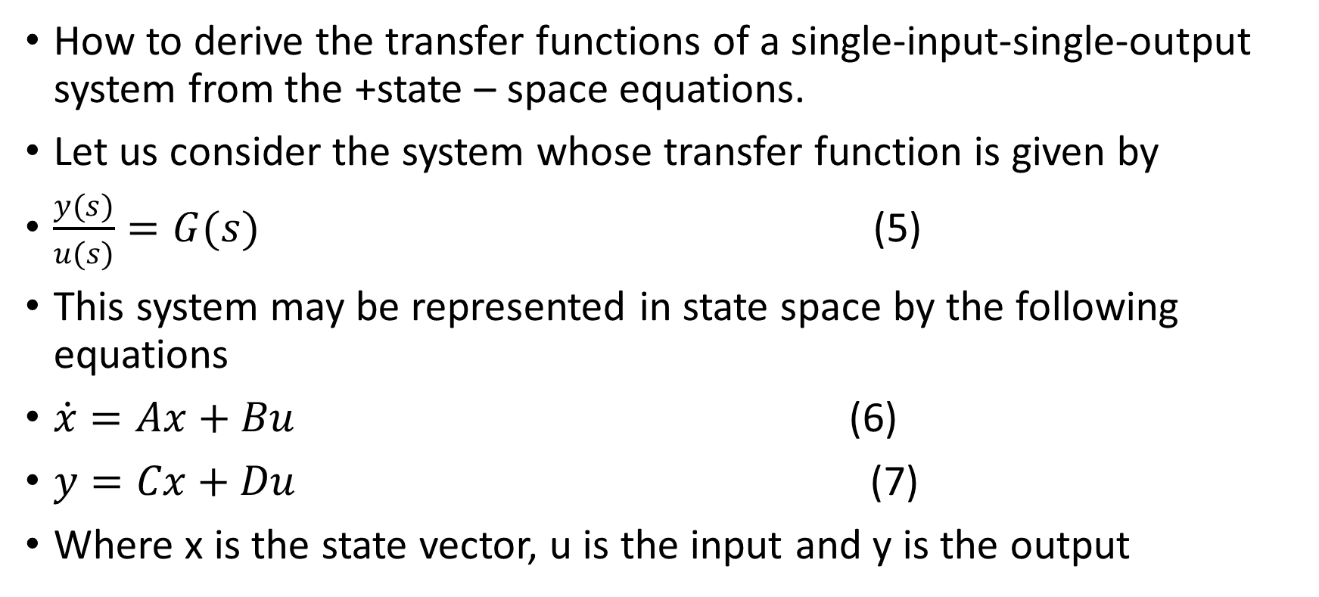
Correlation between transfer functions and state – space equations.
How to derive the transfer functions of a single-input-single-output system from the +state – space equations.
Let us consider the system whose transfer function is given by
$\frac{y(s)}{u(s)}=G(s)$ (5)
This system may be represented in state space by the following equations
$\dot{x}=Ax+Bu$ (6)
$y=Cx+Du$ (7)
Where x is the state vector, u is the input and y is the output

Slide 34
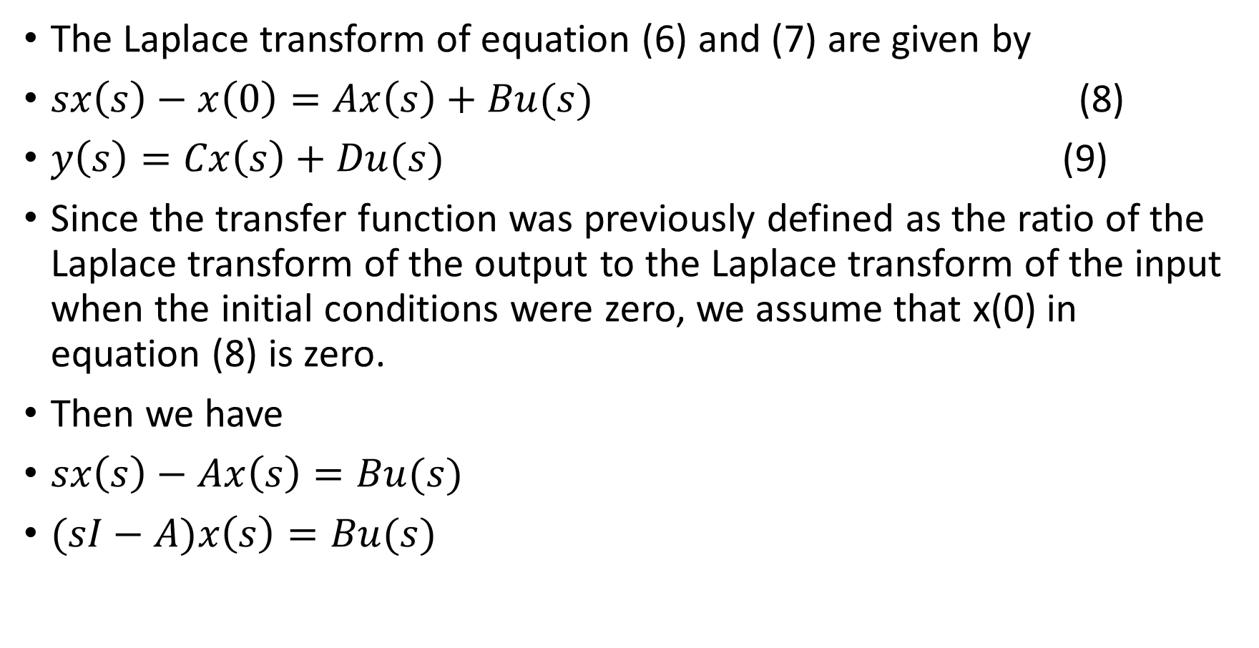
The Laplace transform of equation (6) and (7) are given by
$sx\left(s\right)−x\left(0\right)=Ax\left(s\right)+Bu(s)$ (8)
$y\left(s\right)=Cx\left(s\right)+Du(s)$ (9)
Since the transfer function was previously defined as the ratio of the Laplace transform of the output to the Laplace transform of the input when the initial conditions were zero, we assume that x(0) in equation (8) is zero.
Then we have
$sx\left(s\right)−Ax\left(s\right)=Bu(s)$
$(sI−A)x\left(s\right)=Bu(s)$

Slide 35
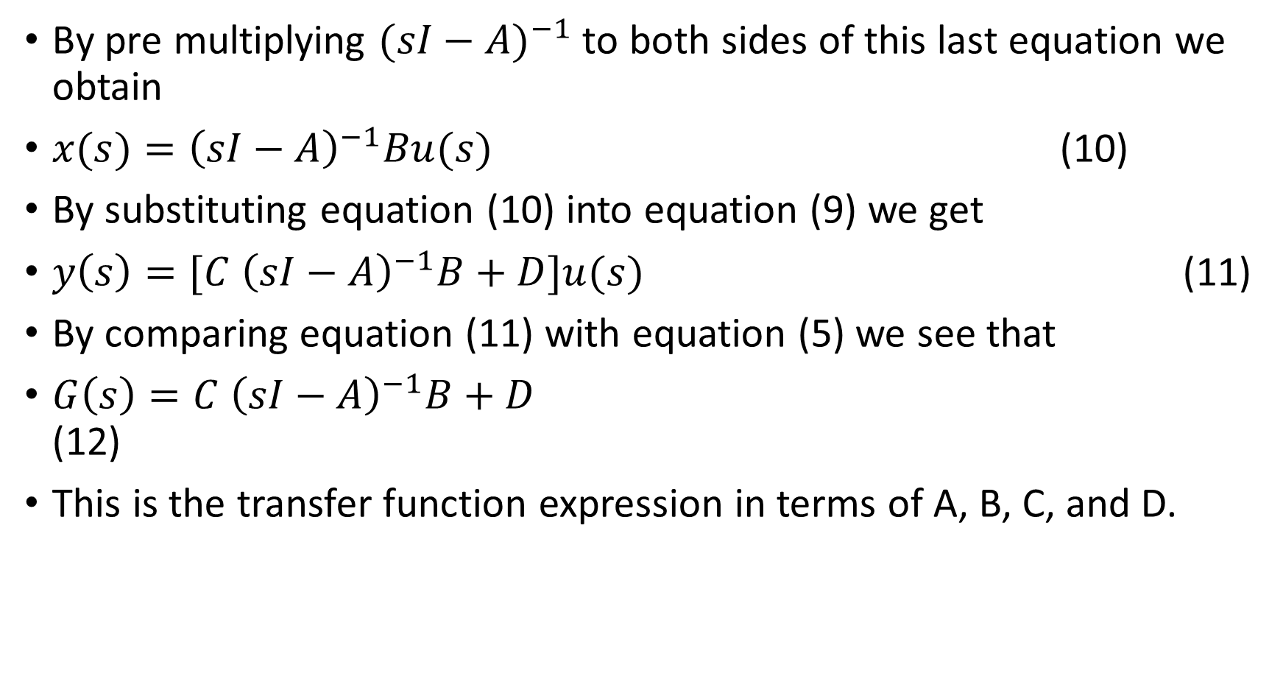
By pre multiplying ${(sI−A)}^{−1}$ to both sides of this last equation we obtain
${x(s)=\left(sI−A\right)}^{−1}Bu(s)$ (10)
By substituting equation (10) into equation (9) we get
$y\left(s\right)=[C$ ${\left(sI−A\right)}^{−1}B+D]u(s)$ (11)
By comparing equation (11) with equation (5) we see that
$G\left(s\right)=C$ ${\left(sI−A\right)}^{−1}B+D$ (12)
This is the transfer function expression in terms of A, B, C, and D.

Slide 36
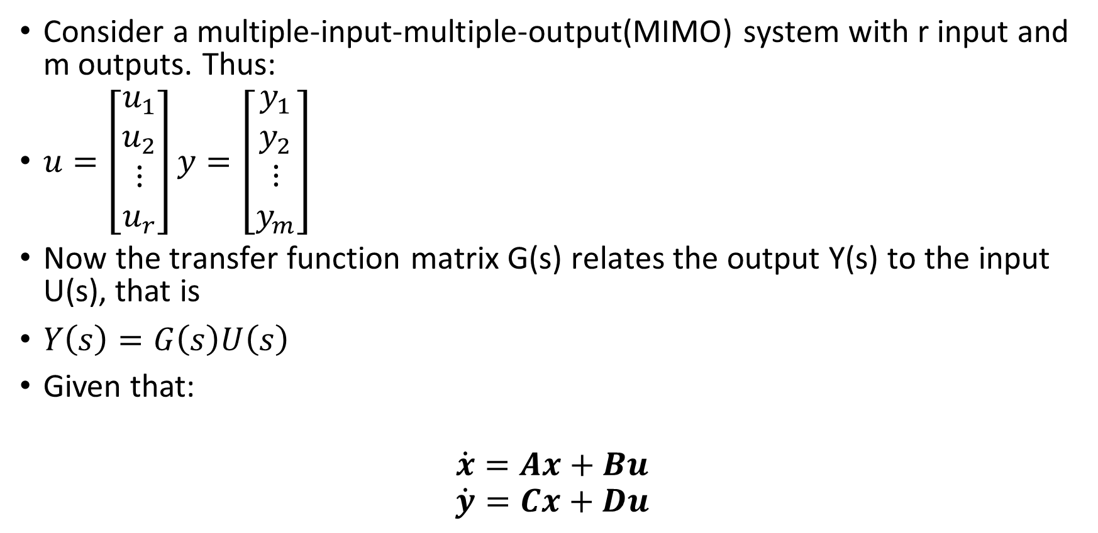
Consider a multiple-input-multiple-output(MIMO) system with r input and m outputs. Thus:
$u=\left[\begin{aligned}u_{1} \\ u_{2} \\ ⋮ \\ u_{r}\end{aligned}\right]y=\left[\begin{aligned}y_{1} \\ y_{2} \\ ⋮ \\ y_{m}\end{aligned}\right]$
Now the transfer function matrix G(s) relates the output Y(s) to the input U(s), that is
$Y\left(s\right)=G\left(s\right)U\left(s\right)$
Given that:
$$\dot{x}=Ax+Bu$$
$$\dot{y}=Cx+Du$$

Slide 37
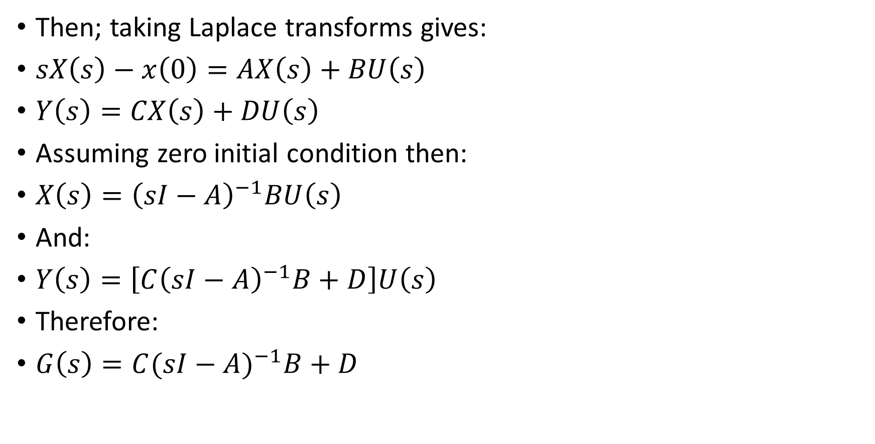
Then; taking Laplace transforms gives:
$sX\left(s\right)−x\left(0\right)=AX\left(s\right)+BU\left(s\right)$
$Y\left(s\right)=CX\left(s\right)+DU\left(s\right)$
Assuming zero initial condition then:
$X\left(s\right)={\left(sI−A\right)}^{−1}BU\left(s\right)$
And:
$Y\left(s\right)=\left[C{\left(sI−A\right)}^{−1}B+D\right]U\left(s\right)$
Therefore:
$G\left(s\right)=C{(sI−A)}^{−1}B+D$

Slide 38
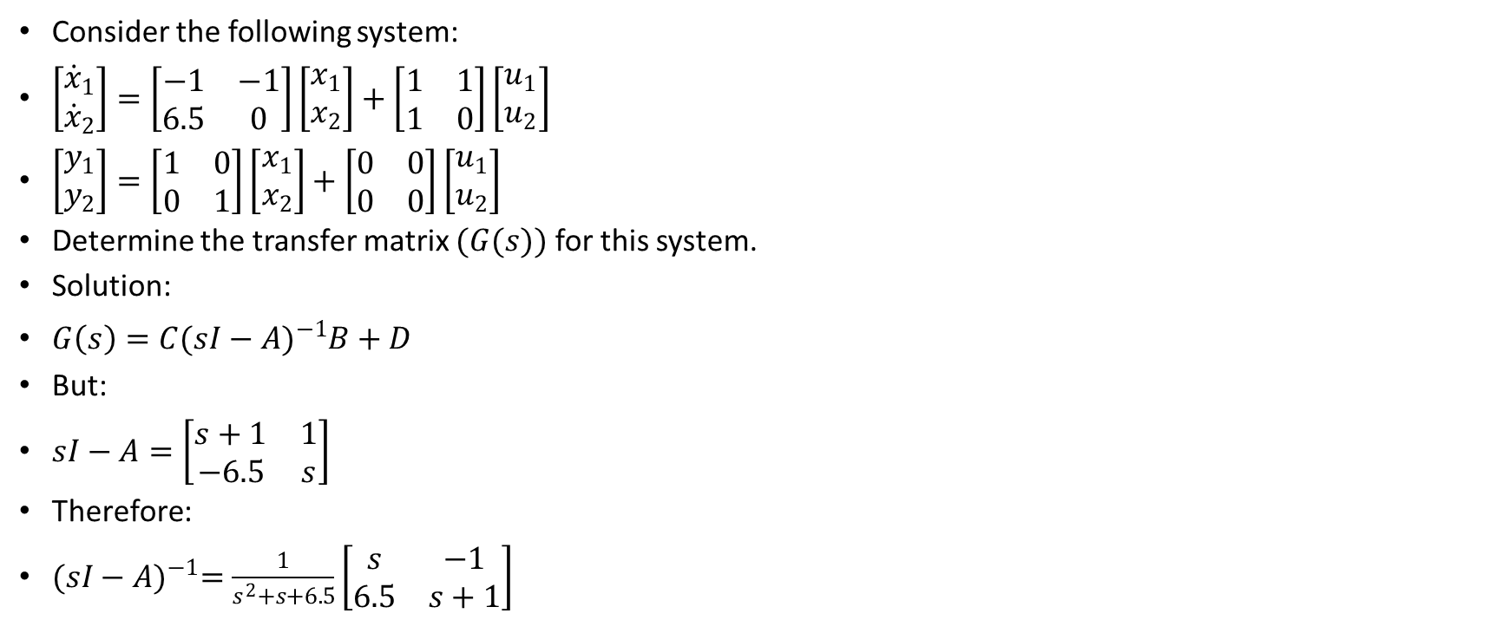
Worked Examples- Transfer Matrix
Consider the following system:
$\left[\begin{aligned}{\dot{x}}_{1} \\ {\dot{x}}_{2}\end{aligned}\right]=\left[\begin{matrix}−1 & −1 \\ 6.5 & 0\end{matrix}\right]\left[\begin{aligned}x_{1} \\ x_{2}\end{aligned}\right]+\left[\begin{matrix}1 & 1 \\ 1 & 0\end{matrix}\right]\left[\begin{aligned}u_{1} \\ u_{2}\end{aligned}\right]$
$\left[\begin{aligned}y_{1} \\ y_{2}\end{aligned}\right]=\left[\begin{matrix}1 & 0 \\ 0 & 1\end{matrix}\right]\left[\begin{aligned}x_{1} \\ x_{2}\end{aligned}\right]+\left[\begin{matrix}0 & 0 \\ 0 & 0\end{matrix}\right]\left[\begin{aligned}u_{1} \\ u_{2}\end{aligned}\right]$
Determine the transfer matrix $(G(s))$ for this system.
Solution:
$G\left(s\right)=C{(sI−A)}^{−1}B+D$
But:
$sI−A=\left[\begin{matrix}s+1 & 1 \\ −6.5 & s\end{matrix}\right]$
Therefore:
${(sI−A)}^{−1}=\frac{1}{s^{2}+s+6.5}\left[\begin{matrix}s & −1 \\ 6.5 & s+1\end{matrix}\right]$

Slide 39
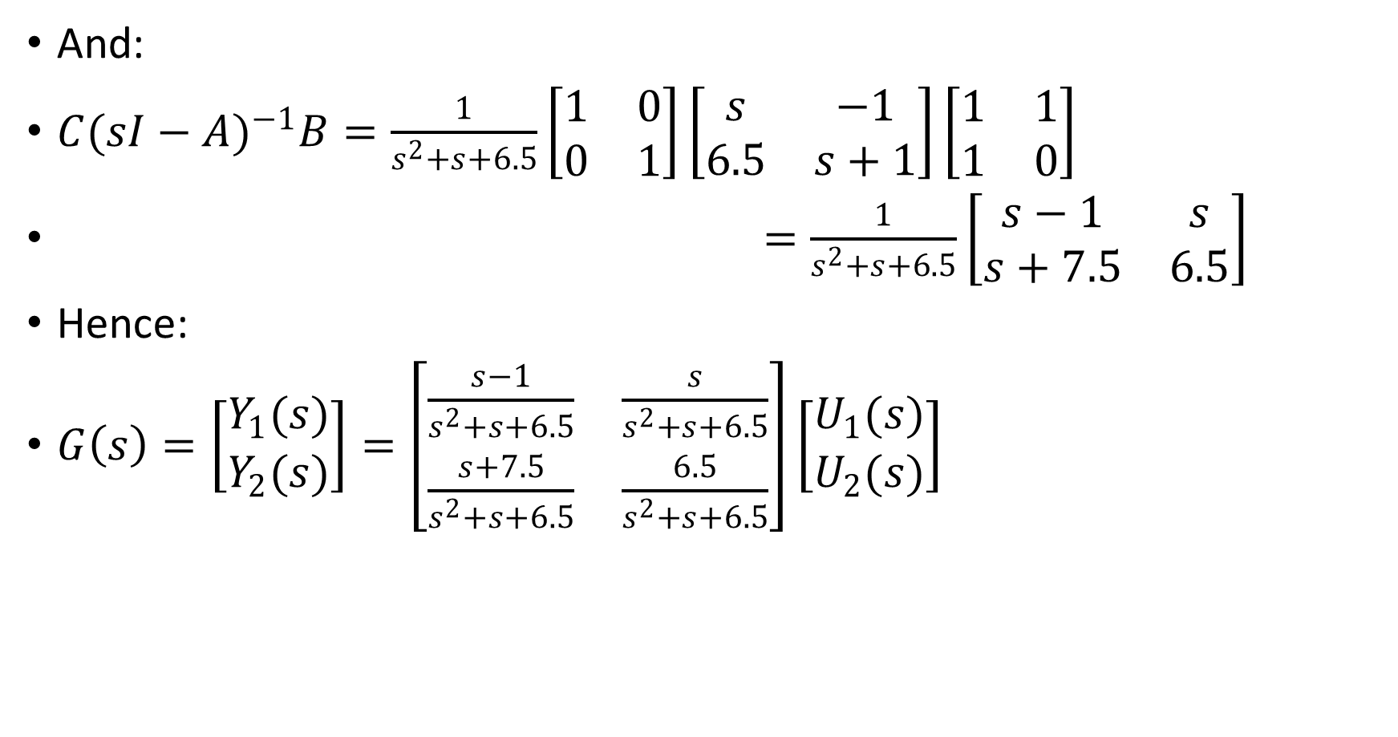
And:
$C{(sI−A)}^{−1}B=\frac{1}{s^{2}+s+6.5}\left[\begin{matrix}1 & 0 \\ 0 & 1\end{matrix}\right]\left[\begin{matrix}s & −1 \\ 6.5 & s+1\end{matrix}\right]\left[\begin{matrix}1 & 1 \\ 1 & 0\end{matrix}\right]$
$=\frac{1}{s^{2}+s+6.5}\left[\begin{matrix}s−1 & s \\ s+7.5 & 6.5\end{matrix}\right]$
Hence:
$G\left(s\right)=\left[\begin{aligned}Y_{1}(s) \\ Y_{2}(s)\end{aligned}\right]=\left[\begin{matrix}\frac{s−1}{s^{2}+s+6.5} & \frac{s}{s^{2}+s+6.5} \\ \frac{s+7.5}{s^{2}+s+6.5} & \frac{6.5}{s^{2}+s+6.5}\end{matrix}\right]\left[\begin{aligned}U_{1}(s) \\ U_{2}(s)\end{aligned}\right]$

Slide 40
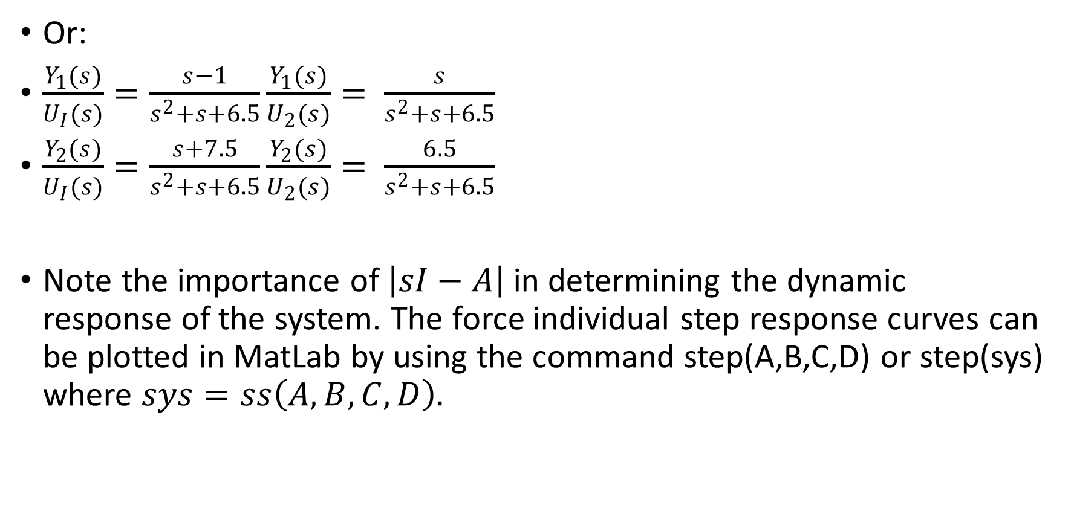
Or:
$\frac{Y_{1}(s)}{U_{I}(s)}=\frac{s−1}{s^{2}+s+6.5}\frac{Y_{1}(s)}{U_{2}(s)}= \frac{s}{s^{2}+s+6.5}$
$\frac{Y_{2}(s)}{U_{I}(s)}=\frac{s+7.5}{s^{2}+s+6.5}\frac{Y_{2}(s)}{U_{2}(s)}= \frac{6.5}{s^{2}+s+6.5}$
Note the importance of $\left|sI−A\right|$ in determining the dynamic response of the system. The force individual step response curves can be plotted in MatLab by using the command step(A,B,C,D) or step(sys) where $sys=ss\left(A,B,C,D\right).$

Slide 41
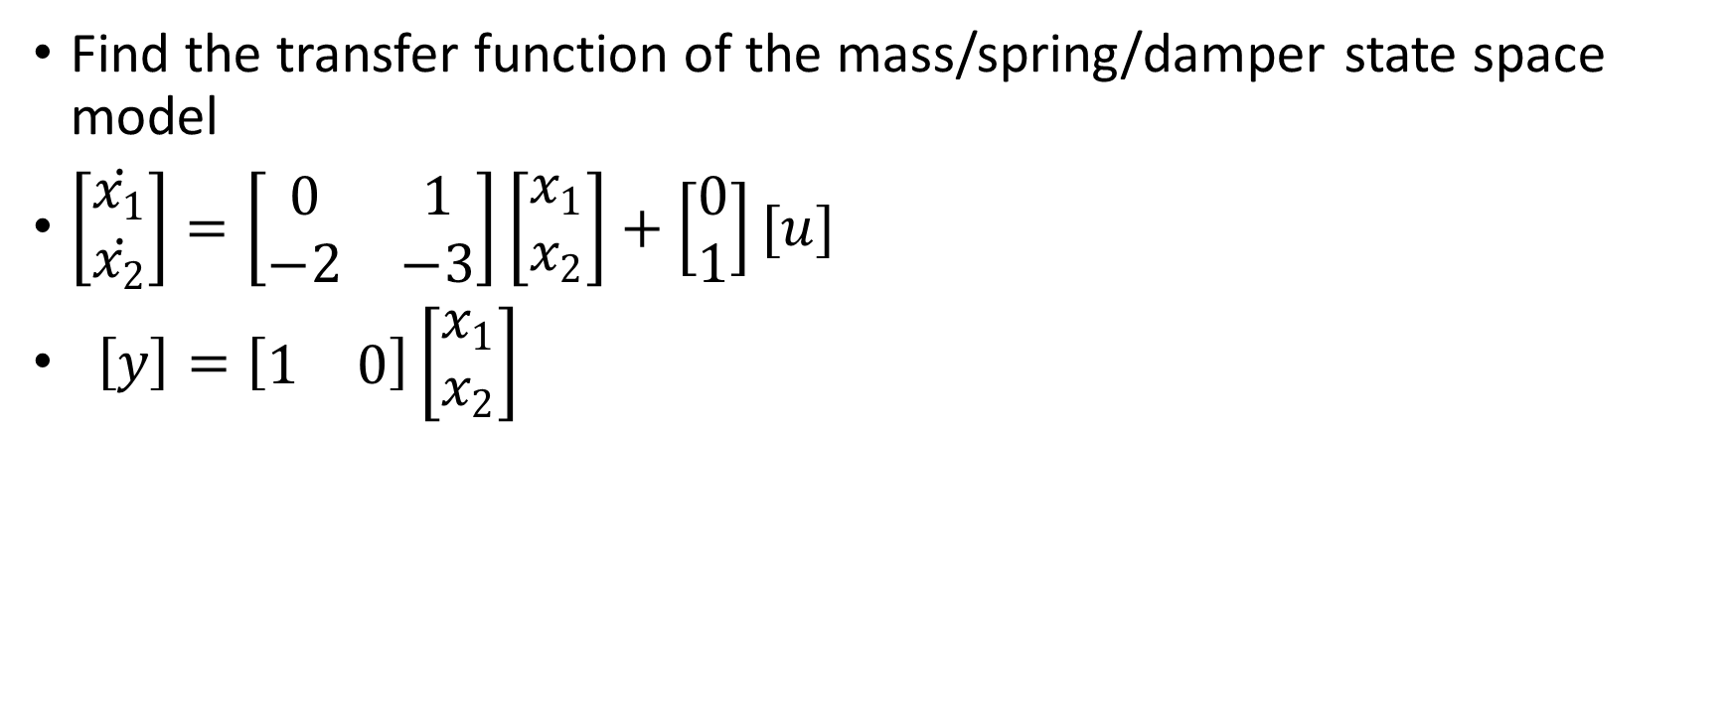
Example 1
Find the transfer function of the mass/spring/damper state space model
$\left[\begin{matrix}\dot{x_{1}} \\ \dot{x_{2}}\end{matrix}\right]=\left[\begin{matrix}0 & 1 \\ −2 & −3\end{matrix}\right]\left[\begin{matrix}x_{1} \\ x_{2}\end{matrix}\right]+\left[\begin{matrix}0 \\ 1\end{matrix}\right][u]$
$\left[y\right]=\left[\begin{matrix}1 & 0\end{matrix}\right]\left[\begin{matrix}x_{1} \\ x_{2}\end{matrix}\right]$

Slide 42
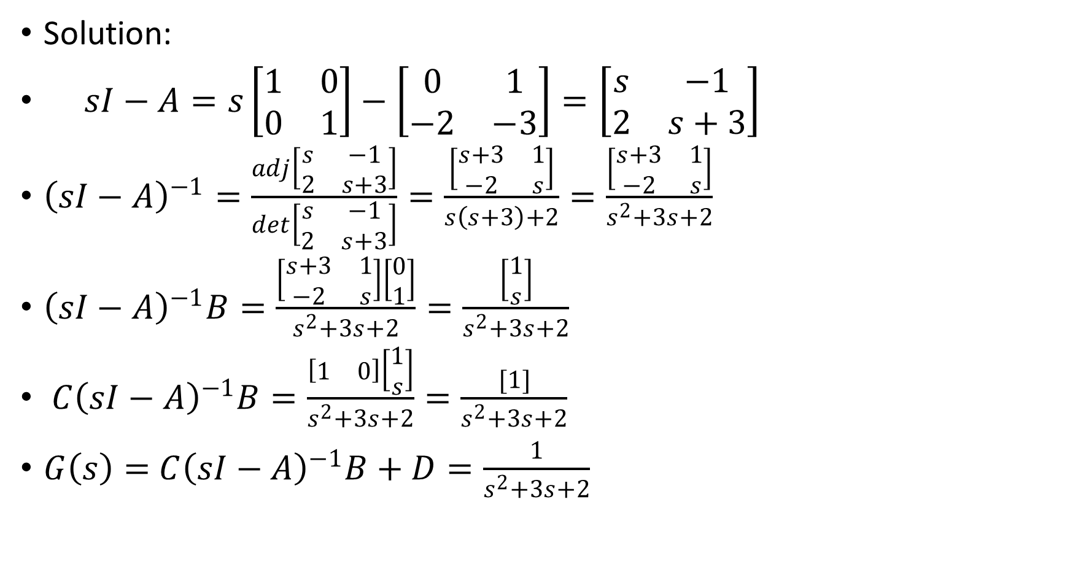
Solution:
$sI−A=s\left[\begin{matrix}1 & 0 \\ 0 & 1\end{matrix}\right]−\left[\begin{matrix}0 & 1 \\ −2 & −3\end{matrix}\right]=\left[\begin{matrix}s & −1 \\ 2 & s+3\end{matrix}\right]$
${\left(sI−A\right)}^{−1}=\frac{adj\left[\begin{matrix}s & −1 \\ 2 & s+3\end{matrix}\right]}{det\left[\begin{matrix}s & −1 \\ 2 & s+3\end{matrix}\right]}=\frac{\left[\begin{matrix}s+3 & 1 \\ −2 & s\end{matrix}\right]}{s\left(s+3\right)+2}=\frac{\left[\begin{matrix}s+3 & 1 \\ −2 & s\end{matrix}\right]}{s^{2}+3s+2}$
${\left(sI−A\right)}^{−1}B=\frac{\left[\begin{matrix}s+3 & 1 \\ −2 & s\end{matrix}\right]\left[\begin{matrix}0 \\ 1\end{matrix}\right]}{s^{2}+3s+2}=\frac{\left[\begin{matrix}1 \\ s\end{matrix}\right]}{s^{2}+3s+2}$
${C\left(sI−A\right)}^{−1}B=\frac{\left[\begin{matrix}1 & 0\end{matrix}\right]\left[\begin{matrix}1 \\ s\end{matrix}\right]}{s^{2}+3s+2}=\frac{[1]}{s^{2}+3s+2}$
$G\left(s\right)=$ ${C\left(sI−A\right)}^{−1}B+D=\frac{1}{s^{2}+3s+2}$

Slide 43
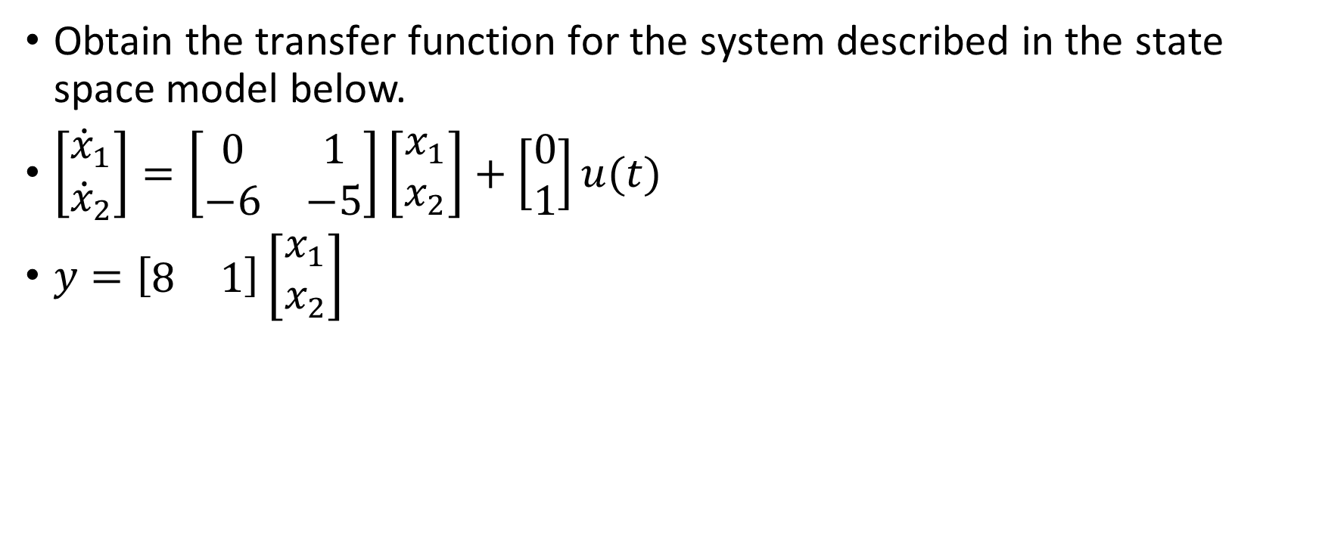
Example 2
Obtain the transfer function for the system described in the state space model below.
$\left[\begin{matrix}{\dot{x}}_{1} \\ {\dot{x}}_{2}\end{matrix}\right]=\left[\begin{matrix}0 & 1 \\ −6 & −5\end{matrix}\right]\left[\begin{matrix}x_{1} \\ x_{2}\end{matrix}\right]+\left[\begin{matrix}0 \\ 1\end{matrix}\right]u(t)$
$y=\left[\begin{matrix}8 & 1\end{matrix}\right]\left[\begin{matrix}x_{1} \\ x_{2}\end{matrix}\right]$

Slide 44
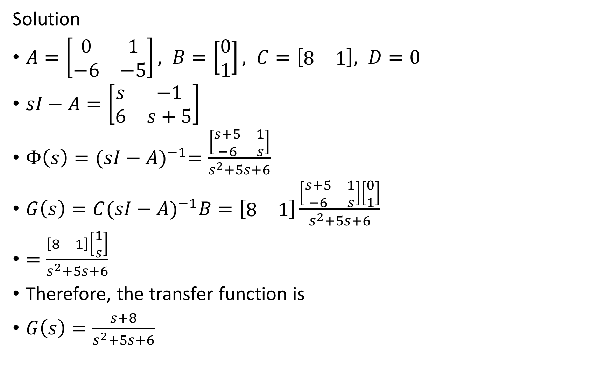
Solution
$A=\left[\begin{matrix}0 & 1 \\ −6 & −5\end{matrix}\right], B=\left[\begin{matrix}0 \\ 1\end{matrix}\right], C=\left[\begin{matrix}8 & 1\end{matrix}\right], D=0$
$sI−A=\left[\begin{matrix}s & −1 \\ 6 & s+5\end{matrix}\right]$
$Φ\left(s\right)={(sI−A)}^{−1}=\frac{\left[\begin{matrix}s+5 & 1 \\ −6 & s\end{matrix}\right]}{s^{2}+5s+6}$
$G\left(s\right)=C{(sI−A)}^{−1}B=\left[\begin{matrix}8 & 1\end{matrix}\right]\frac{\left[\begin{matrix}s+5 & 1 \\ −6 & s\end{matrix}\right]\left[\begin{matrix}0 \\ 1\end{matrix}\right]}{s^{2}+5s+6}$
$=\frac{\left[\begin{matrix}8 & 1\end{matrix}\right]\left[\begin{matrix}1 \\ s\end{matrix}\right]}{s^{2}+5s+6}$
Therefore, the transfer function is
$G\left(s\right)=\frac{s+8}{s^{2}+5s+6}$

Slide 45
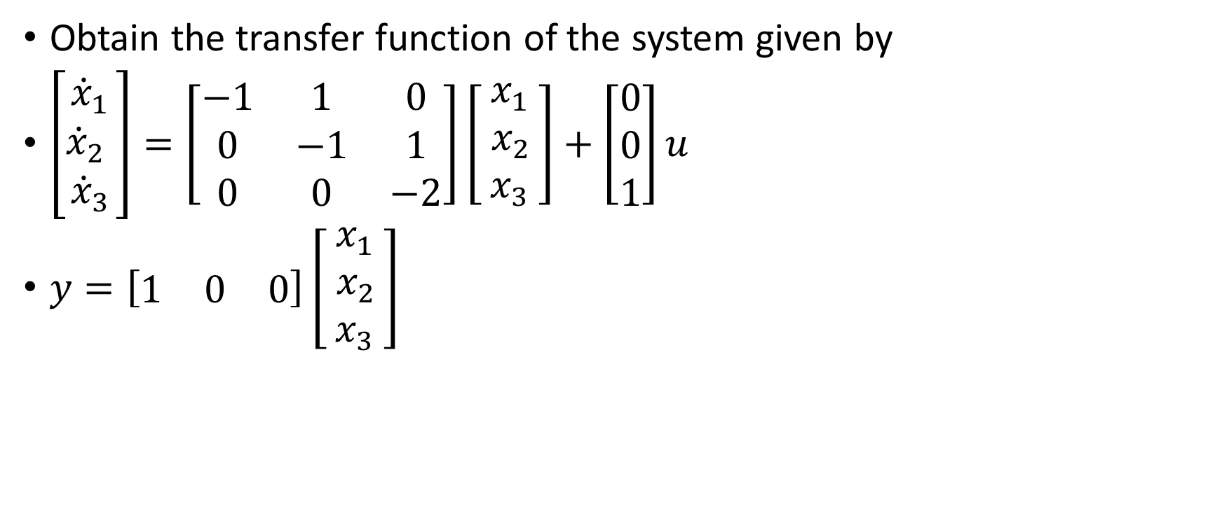
Example 3
Obtain the transfer function of the system given by
$\left[\begin{matrix}{\dot{x}}_{1} \\ {\dot{x}}_{2} \\ {\dot{x}}_{3}\end{matrix}\right]=\left[\begin{matrix}−1 & 1 & 0 \\ 0 & −1 & 1 \\ 0 & 0 & −2\end{matrix}\right]\left[\begin{matrix}x_{1} \\ { x}_{2 } \\ x_{3}\end{matrix}\right]+\left[\begin{matrix}0 \\ 0 \\ 1\end{matrix}\right]u$
$y=\left[\begin{matrix}1 & 0 & 0\end{matrix}\right]\left[\begin{matrix}x_{1} \\ { x}_{2 } \\ x_{3}\end{matrix}\right]$

Slide 46
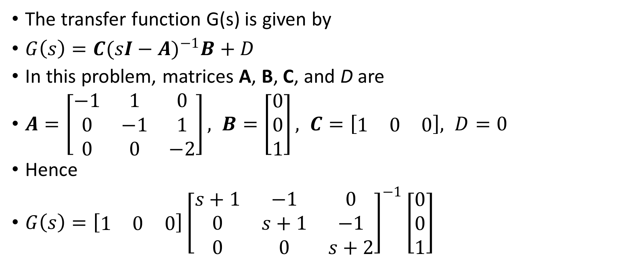
Solution
The transfer function G(s) is given by
$G\left(s\right)=C{(sI−A)}^{−1}B+D$
In this problem, matrices A, B, C, and D are
$A=\left[\begin{matrix}−1 & 1 & 0 \\ 0 & −1 & 1 \\ 0 & 0 & −2\end{matrix}\right], B=\left[\begin{matrix}0 \\ 0 \\ 1\end{matrix}\right], C=\left[\begin{matrix}1 & 0 & 0\end{matrix}\right], D=0$
Hence
$G\left(s\right)=\left[\begin{matrix}1 & 0 & 0\end{matrix}\right]{\left[\begin{matrix}s+1 & −1 & 0 \\ 0 & s+1 & −1 \\ 0 & 0 & s+2\end{matrix}\right]}^{−1}\left[\begin{matrix}0 \\ 0 \\ 1\end{matrix}\right]$

Slide 47
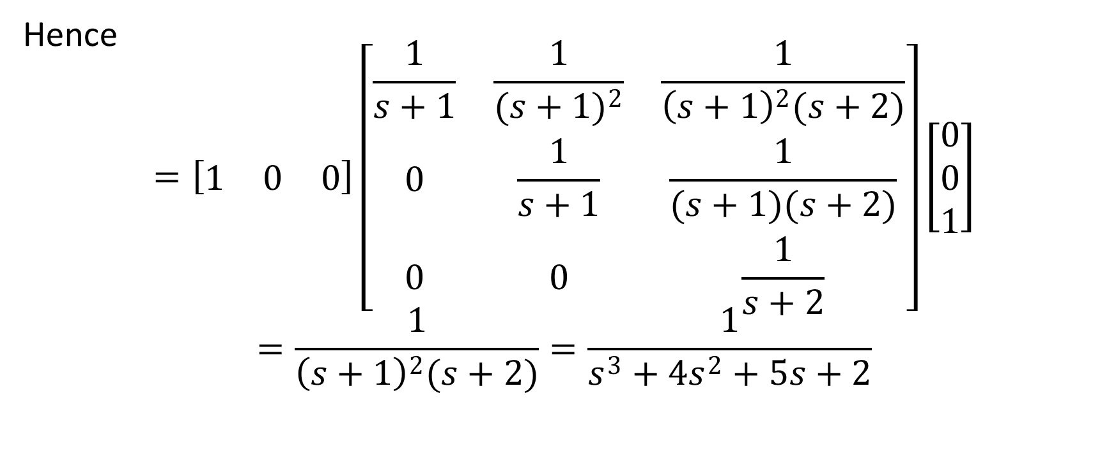
Solution
Hence
$$=\left[\begin{matrix}1 & 0 & 0\end{matrix}\right]\left[\begin{matrix}\frac{1}{s+1} & \frac{1}{{(s+1)}^{2}} & \frac{1}{{\left(s+1\right)}^{2}(s+2)} \\ 0 & \frac{1}{s+1} & \frac{1}{(s+1)(s+2)} \\ 0 & 0 & \frac{1}{s+2}\end{matrix}\right]\left[\begin{matrix}0 \\ 0 \\ 1\end{matrix}\right]$$
$$=\frac{1}{{\left(s+1\right)}^{2}(s+2)}=\frac{1}{s^{3}+{4s}^{2}+5s+2}$$

Slide 48
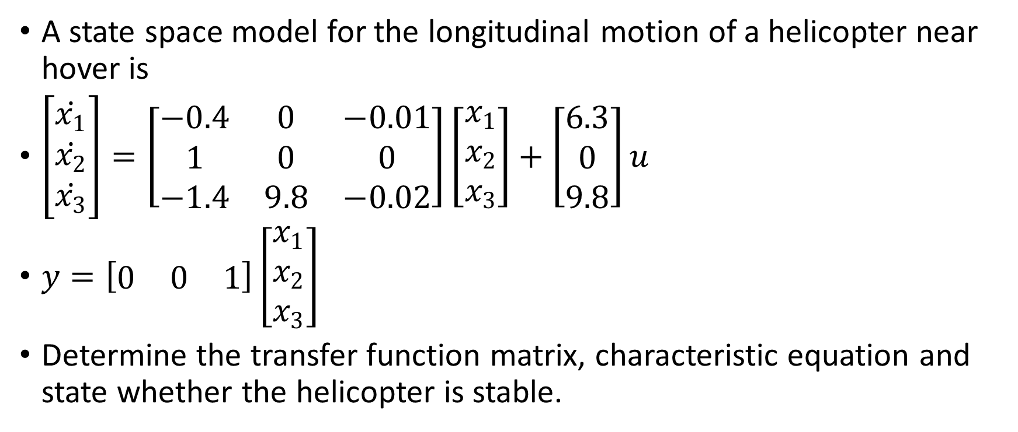
Assignment
A state space model for the longitudinal motion of a helicopter near hover is
$\left[\begin{matrix}\dot{x_{1}} \\ \dot{x_{2}} \\ \dot{x_{3}}\end{matrix}\right]=\left[\begin{matrix}−0.4 & 0 & −0.01 \\ 1 & 0 & 0 \\ −1.4 & 9.8 & −0.02\end{matrix}\right]\left[\begin{matrix}x_{1} \\ x_{2} \\ x_{3}\end{matrix}\right]+\left[\begin{matrix}6.3 \\ 0 \\ 9.8\end{matrix}\right]u$
$y=\left[\begin{matrix}0 & 0 & 1\end{matrix}\right]\left[\begin{matrix}x_{1} \\ x_{2} \\ x_{3}\end{matrix}\right]$
Determine the transfer function matrix, characteristic equation and state whether the helicopter is stable.

Slide 49
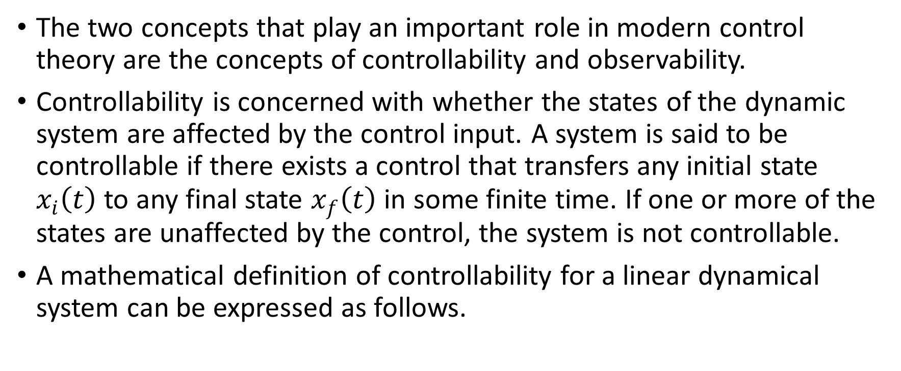
Controllability And Observability
The two concepts that play an important role in modern control theory are the concepts of controllability and observability.
Controllability is concerned with whether the states of the dynamic system are affected by the control input. A system is said to be controllable if there exists a control that transfers any initial state $x_{i}\left(t\right)$ to any final state $x_{f}\left(t\right)$ in some finite time. If one or more of the states are unaffected by the control, the system is not controllable.
A mathematical definition of controllability for a linear dynamical system can be expressed as follows.

Slide 50
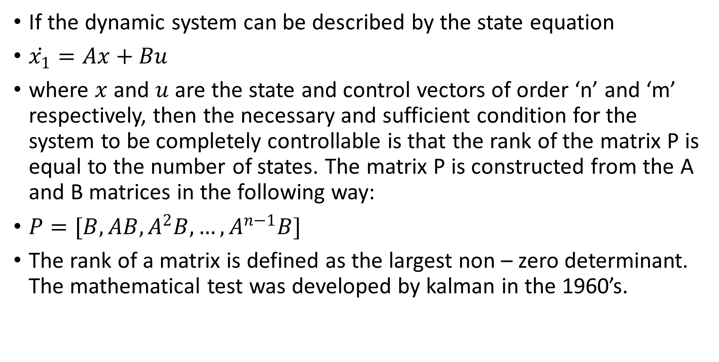
If the dynamic system can be described by the state equation
$\dot{x_{1}}=Ax+Bu$
where $x$ and $u$ are the state and control vectors of order ‘n’ and ‘m’ respectively, then the necessary and sufficient condition for the system to be completely controllable is that the rank of the matrix P is equal to the number of states. The matrix P is constructed from the A and B matrices in the following way:
$P=[B,AB,A^{2}B, …, A^{n−1}B]$
The rank of a matrix is defined as the largest non – zero determinant. The mathematical test was developed by kalman in the 1960’s.

Slide 51
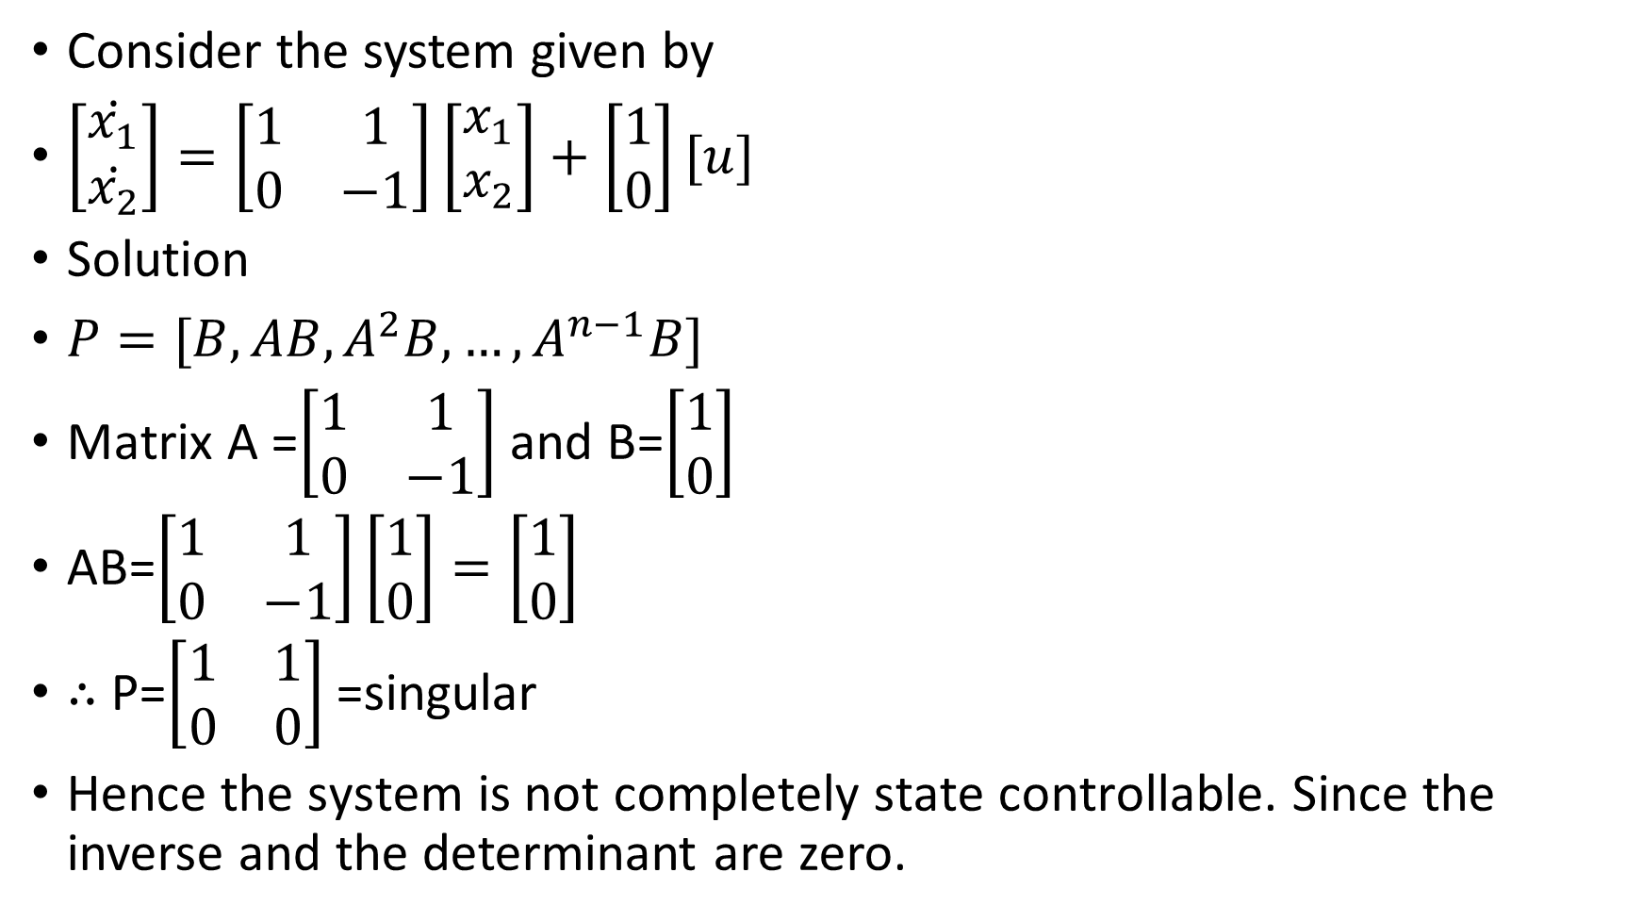
Example
Consider the system given by
$\left[\begin{matrix}\dot{x_{1}} \\ \dot{x_{2}}\end{matrix}\right]=\left[\begin{matrix}1 & 1 \\ 0 & −1\end{matrix}\right]\left[\begin{matrix}x_{1} \\ x_{2}\end{matrix}\right]+\left[\begin{matrix}1 \\ 0\end{matrix}\right][u]$
Solution
$P=[B,AB,A^{2}B, …, A^{n−1}B]$
Matrix A =$\left[\begin{matrix}1 & 1 \\ 0 & −1\end{matrix}\right]$ and B=$\left[\begin{matrix}1 \\ 0\end{matrix}\right]$
AB=$\left[\begin{matrix}1 & 1 \\ 0 & −1\end{matrix}\right]\left[\begin{matrix}1 \\ 0\end{matrix}\right]=\left[\begin{matrix}1 \\ 0\end{matrix}\right]$
∴ P=$\left[\begin{matrix}1 & 1 \\ 0 & 0\end{matrix}\right]$=singular
Hence the system is not completely state controllable. Since the inverse and the determinant are zero.

Slide 52

Try
Consider the system given by
$\left[\begin{matrix}\dot{x_{1}} \\ \dot{x_{2}}\end{matrix}\right]=\left[\begin{matrix}1 & 1 \\ 2 & −1\end{matrix}\right]\left[\begin{matrix}x_{1} \\ x_{2}\end{matrix}\right]+\left[\begin{matrix}0 \\ 1\end{matrix}\right][u]$
is controllable.

Slide 53
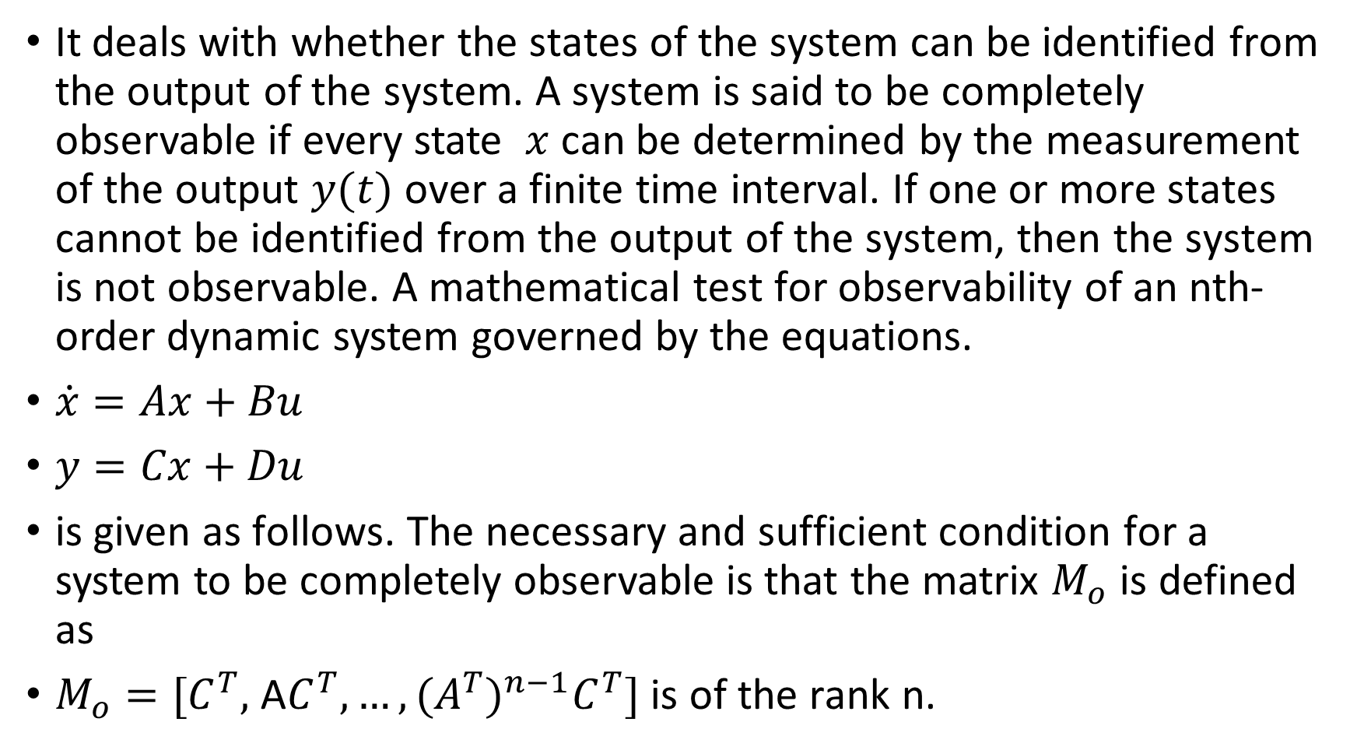
Observability
It deals with whether the states of the system can be identified from the output of the system. A system is said to be completely observable if every state $x$ can be determined by the measurement of the output $y(t)$ over a finite time interval. If one or more states cannot be identified from the output of the system, then the system is not observable. A mathematical test for observability of an nth-order dynamic system governed by the equations.
$\dot{x}=Ax+Bu$
$y=Cx+Du$
is given as follows. The necessary and sufficient condition for a system to be completely observable is that the matrix $M_{o}$ is defined as
$M_{o}=[C^{T},$ A$C^{T}, …, {{(A}^{T})}^{n−1}C^{T}]$ is of the rank n.

Slide 54
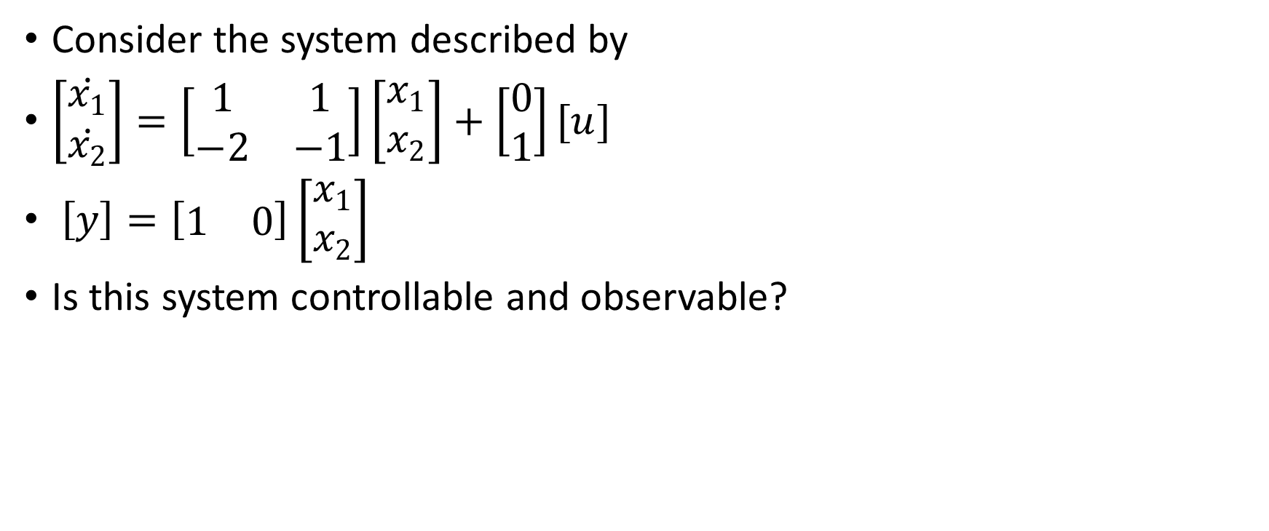
Example
Consider the system described by
$\left[\begin{matrix}\dot{x_{1}} \\ \dot{x_{2}}\end{matrix}\right]=\left[\begin{matrix}1 & 1 \\ −2 & −1\end{matrix}\right]\left[\begin{matrix}x_{1} \\ x_{2}\end{matrix}\right]+\left[\begin{matrix}0 \\ 1\end{matrix}\right][u]$
$\left[y\right]=\left[\begin{matrix}1 & 0\end{matrix}\right]\left[\begin{matrix}x_{1} \\ x_{2}\end{matrix}\right]$
Is this system controllable and observable?

Slide 55
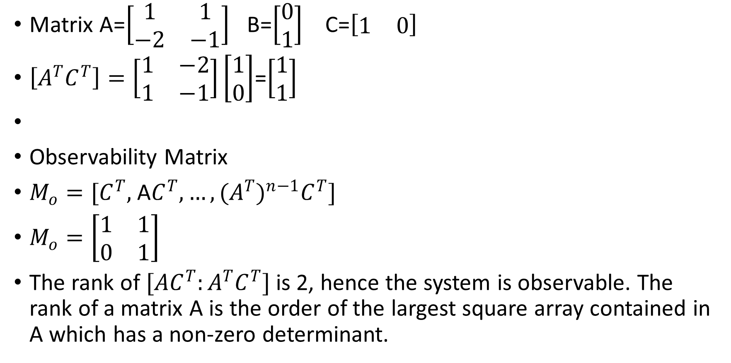
Solution
Matrix A=$\left[\begin{matrix}1 & 1 \\ −2 & −1\end{matrix}\right]$ B=$\left[\begin{matrix}0 \\ 1\end{matrix}\right]$ C=$\left[\begin{matrix}1 & 0\end{matrix}\right]$
$\left[A^{T}C^{T}\right]=\left[\begin{matrix}1 & −2 \\ 1 & −1\end{matrix}\right]\left[\begin{matrix}1 \\ 0\end{matrix}\right]$=$\left[\begin{matrix}1 \\ 1\end{matrix}\right]$
Observability Matrix
$M_{o}=[C^{T},$ A$C^{T}, …, {{(A}^{T})}^{n−1}C^{T}]$
$M_{o}=\left[\begin{matrix}1 & 1 \\ 0 & 1\end{matrix}\right]$
The rank of ${[AC}^{T}:A^{T}C^{T}]$is 2, hence the system is observable. The rank of a matrix A is the order of the largest square array contained in A which has a non-zero determinant.

Slide 56

Example

Slide 57

Exercise
Which of the systems are fully controllable
$\dot{x}=\left[\begin{matrix}1 & 4 \\ −2 & −5\end{matrix}\right]x+\left[\begin{aligned}0 \\ 1\end{aligned}\right]u$
$\dot{x}=\left[\begin{matrix}0 & 4 \\ −2 & 6\end{matrix}\right]x+\left[\begin{aligned}1 \\ 1\end{aligned}\right]u$
$\dot{x}=\left[\begin{matrix}1 & 0 \\ −8 & −5\end{matrix}\right]x+\left[\begin{aligned}0 \\ 1\end{aligned}\right]u$
$\dot{x}=\left[\begin{matrix}0 & 4 \\ −2 & −6\end{matrix}\right]x+\left[\begin{aligned}1 \\ 1\end{aligned}\right]u$

